Slide 1

Flutter-Workshop
Julian Hartl

Slide 2
Overview
Why Flutter?
Flutter basics
Dart crash course
Developing a shopping list app
Building your own app
Outlook

Slide 3
Why Flutter?
What even is Flutter?

Slide 4
What even is Flutter?
“Flutter is an open source framework by Google for building beautiful, natively compiled, multi-platform applications from a single codebase.”

Slide 5
What even is Flutter?
“Flutter is an open source framework by Google for building beautiful, natively compiled, multi-platform applications from a single codebase.”
Open source UI software development toolkit
Natively compiled
Supports many platforms

Slide 6
Why Flutter?
What is your experience with app development, and what are your expectations for the workshop?
Notes:
Was sind eure Erfahrung mit App Entwicklung?
Was erhofft ihr euch von diesem Workshop?

Slide 7
Why Flutter?
What does Flutter offer?

Slide 8
What does Flutter offer?
Cross-Platform development (Android, iOS, Web, Windows, macOS, Linux, Fuchsia)

Slide 9
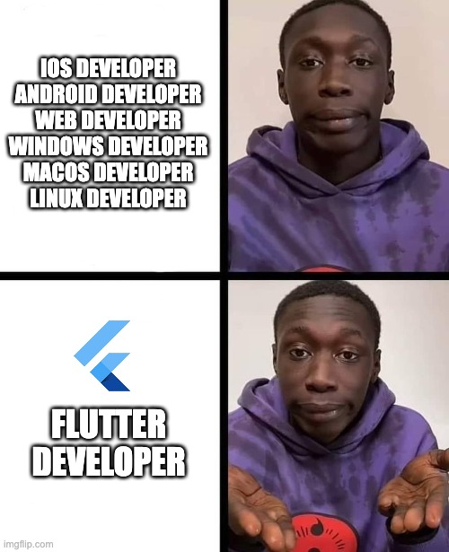
What does Flutter offer?
Cross-Platform development (Android, iOS, Web, Windows, macOS, Linux, Fuchsia)

Slide 10
What does Flutter offer?
Cross-Platform development (Android, iOS, Web, Windows, macOS, Linux, Fuchsia)
Performant due to Ahead-of-Time (AOT) Compilation

Slide 11
What does Flutter offer?
Cross-Platform development (Android, iOS, Web, Windows, macOS, Linux, Fuchsia)
Performant due to Ahead-of-Time (AOT) Compilation
Expressive and flexible UI (large set of prebuilt components)

Slide 12
What does Flutter offer?
Cross-Platform development (Android, iOS, Web, Windows, macOS, Linux, Fuchsia)
Performant due to Ahead-of-Time (AOT) Compilation
Expressive and flexible UI (large set of prebuilt components)
Hot reload (instant UI updates)

Slide 13
What does Flutter offer?
Cross-Platform development (Android, iOS, Web, Windows, macOS, Linux, Fuchsia)
Performant due to Ahead-of-Time (AOT) Compilation
Expressive and flexible UI (large set of prebuilt components)
Hot reload (instant UI updates)
Consistent behavior across all platforms

Slide 14
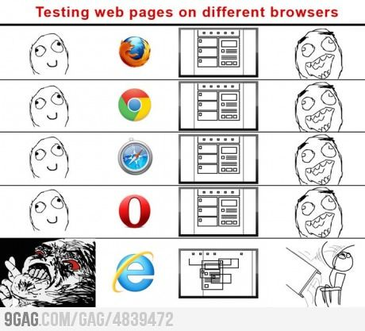
What does Flutter offer?
Cross-Platform development (Android, iOS, Web, Windows, macOS, Linux, Fuchsia)
Performant due to Ahead-of-Time (AOT) Compilation
Expressive and flexible UI (large set of prebuilt components)
Hot reload (instant UI updates)
Consistent behavior across all platforms

Slide 15
What does Flutter offer?
Cross-Platform development (Android, iOS, Web, Windows, macOS, Linux, Fuchsia)
Performant due to Ahead-of-Time (AOT) Compilation
Expressive and flexible UI (large set of prebuilt components)
Hot reload (instant UI updates)
Consistent behavior across all platforms
Strong community and ecosystem (wide adoption in the industry)

Slide 16
Why Flutter?
Applications in the real world

Slide 17

BMW
Feature and design discrepancies between their iOS and Android offering had grown too large
💭 Not yet mature enough
✅ Not web based => better UX
✅ Build & design once

Slide 18
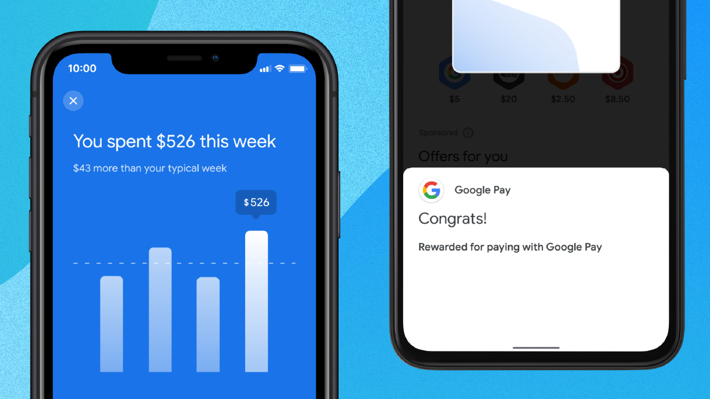
Google-Pay
Building every feature twice
💭 Heavy upfront investment of engineering resources (retraining, reapproval, …)
✅ 70% reduction in engineering effort
✅ 35% reduction in lines of code
✅ Saved about 60-70% of their engineer’s time

Slide 19
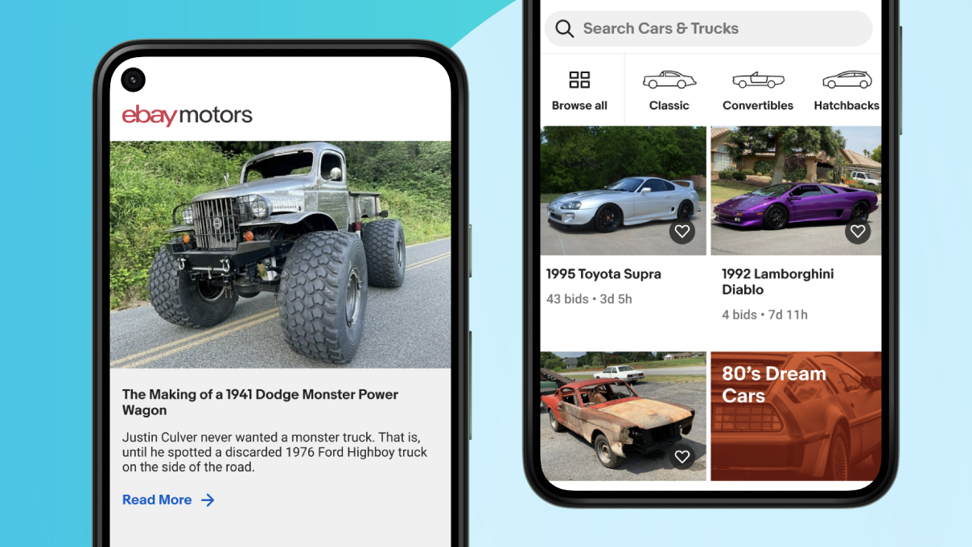
eBay
Building a new app to buy and sell hard-to-find cars for both Android and iOS in under a year
✅ Time-saving and design capabilities
✅ Hot reload
✅ Built-in testing
✅ Code sharing

Slide 20
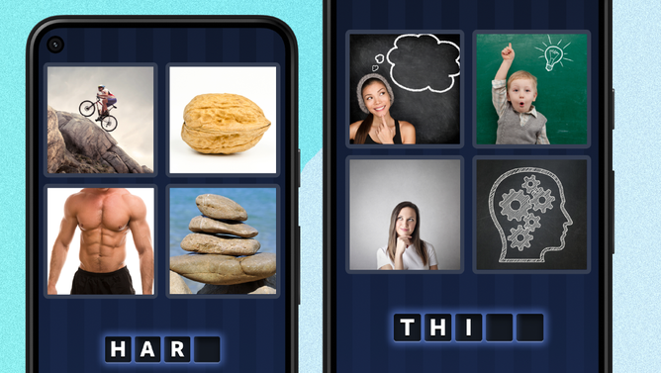
4 Pics 1 Word
Giving 4 Pics 1 Word a tuneup
✅ No more troubleshooting cross-platform functionality
✅ Performs offline on low-end devices
✅ 99.9% crash-free rate

Slide 21

Why Flutter?
Flutter at the SelectCode

Slide 22
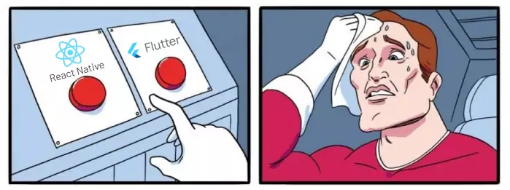
Why Flutter?
Flutter compared to React Native

Slide 23
Flutter vs. React Native
Flutter
React Native
Comprehensive set of prebuilt UI components following Material Design & Cupertino guidelines
Core components, but for more complete UI, developers often rely on third-party libraries

Slide 24
Flutter vs. React Native
Flutter
React Native
Comprehensive set of prebuilt UI components following Material Design & Cupertino guidelines
AOT compiled to native code, ensuring faster startup and performance
Core components, but for more complete UI, developers often rely on third-party libraries
Uses JavaScript, which is interpreted at runtime and therefore only close to native performance

Slide 25
Flutter vs. React Native
Flutter
React Native
Comprehensive set of prebuilt UI components following Material Design & Cupertino guidelines
AOT compiled to native code, ensuring faster startup and performance
Has a powerful graphics engine (Skia) that supports complex customizations and graphics (animations, …)
Core components, but for more complete UI, developers often rely on third-party libraries
Uses JavaScript, which is interpreted at runtime and therefore only close to native performance
While possible, achieving the same level of complexity as Flutter might require additional work & third-party libraries

Slide 26
Flutter vs. React Native
Flutter
React Native
Comprehensive set of prebuilt UI components following Material Design & Cupertino guidelines
AOT compiled to native code, ensuring faster startup and performance
Has a powerful graphics engine (Skia) that supports complex customizations and graphics (animations, …)
Although younger, it has a rapidly growing community
Core components, but for more complete UI, developers often rely on third-party libraries
Uses JavaScript, which is interpreted at runtime and therefore only close to native performance
While possible, achieving the same level of complexity as Flutter might require additional work & third-party libraries
Established community with a vast number of libraries

Slide 27
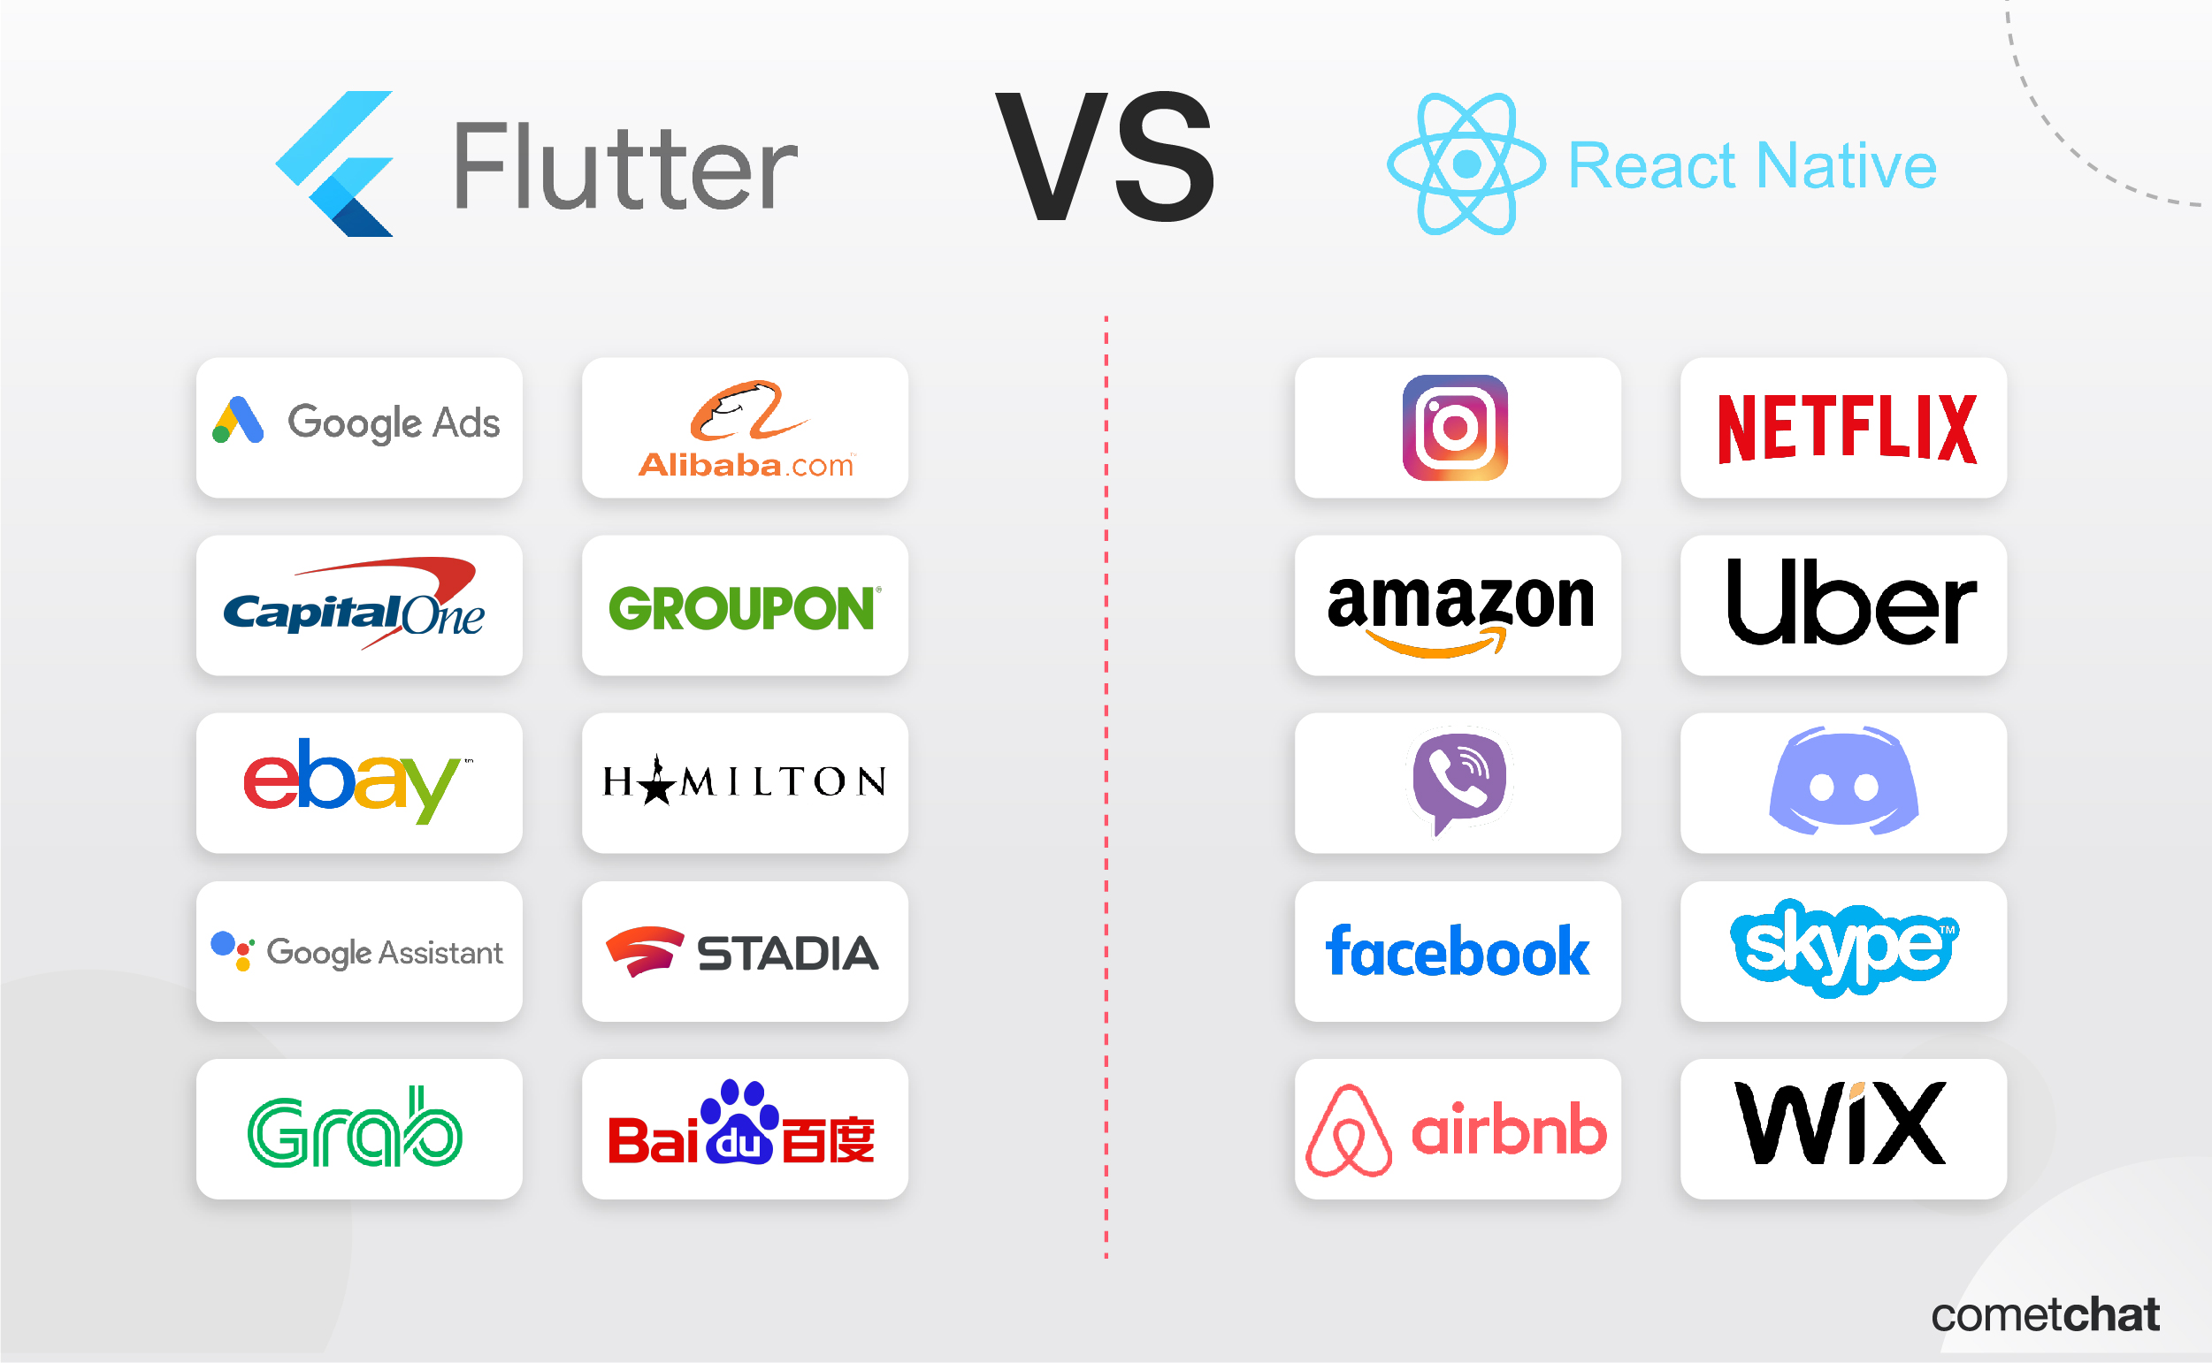
Flutter vs. React Native

Slide 28
Why Flutter?
Flutter compared to native development

Slide 29
Flutter vs. Native
Flutter
Native
Cross-Platform
Supports only one platform

Slide 30
Flutter vs. Native
Flutter
Native
Cross-Platform
Consistent design
Supports only one platform
Design can vary between devices

Slide 31
Flutter vs. Native
Flutter
Native
Cross-Platform
Consistent design
One codebase
Supports only one platform
Design can vary between devices
Two separate codebases

Slide 32
Flutter vs. Native
Flutter
Native
Cross-Platform
Consistent design
One codebase
May require additional work for platform-specific features
Supports only one platform
Design can vary between devices
Two separate codebases
Direct access to native functionalities

Slide 33
Flutter basics
Widgets

Slide 34
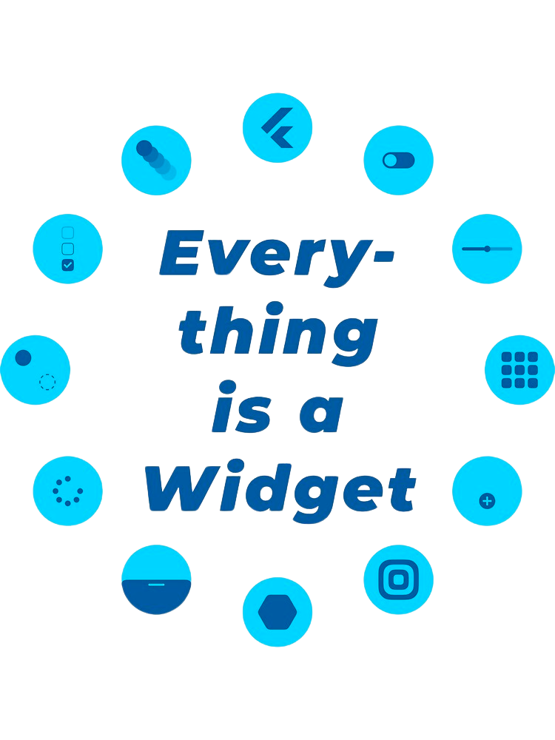
Notes:
jeder Screen besteht aus einer Vielzahl an Widgets

Slide 35
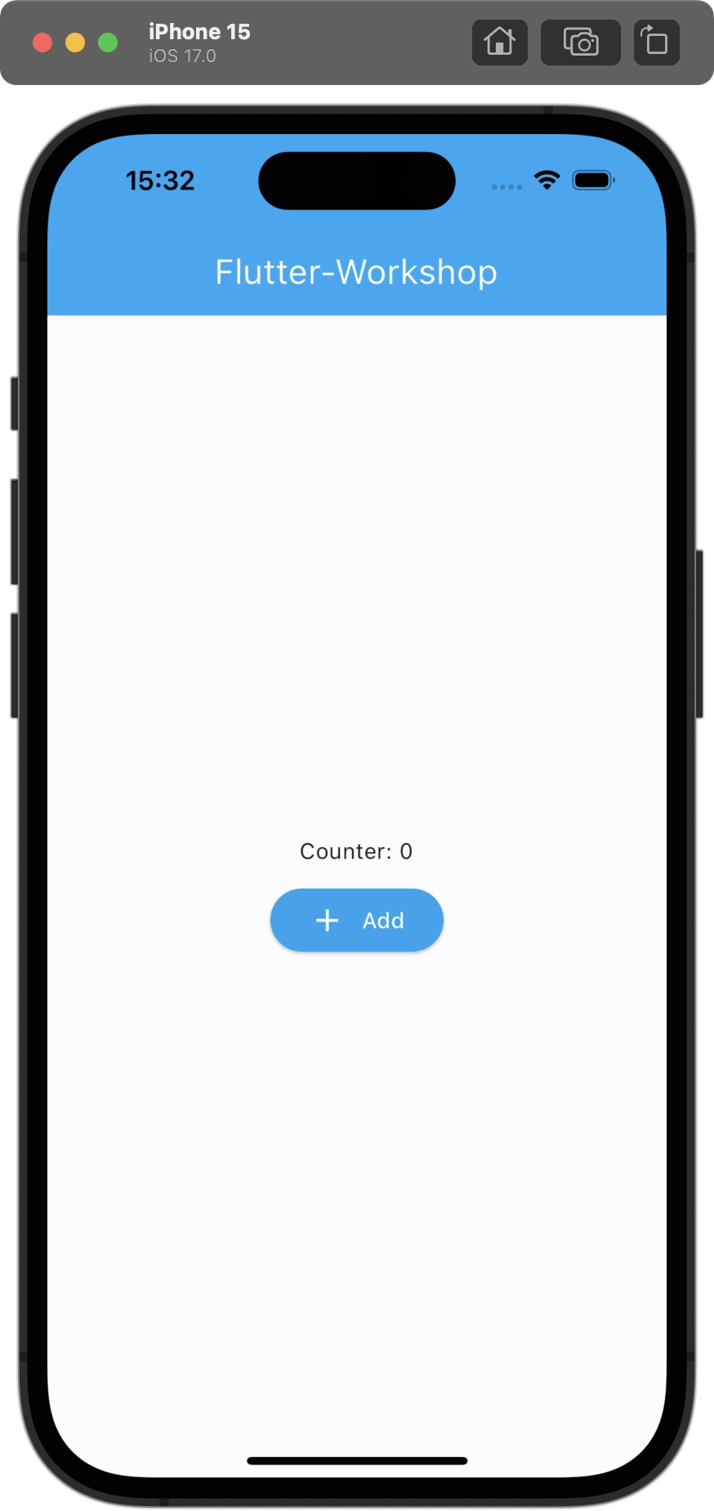

Slide 36
Root Widget

Slide 37
Root Widget

Slide 38
Root Widget
App Bar Widget

Slide 39
Root Widget
App Bar Widget
Text Widget

Slide 40
Root Widget
App Bar Widget
Center Widget
Text Widget

Slide 41
Root Widget
App Bar Widget
Center Widget
Text Widget
Column Widget

Slide 42
Root Widget
App Bar Widget
Center Widget
Text Widget
Column Widget
Text Widget

Slide 43
Root Widget
App Bar Widget
Center Widget
Text Widget
Column Widget
Text Widget
ElevatedButton Widget

Slide 44
Widgets
Text Widget
Container Widget
Row Widget
Column Widget

Slide 45
Widgets
Text Widget
Container Widget
Row Widget
Column Widget
style
textAlign
overflow
maxLines
… etc

Slide 46
Widgets
Text Widget
Container Widget
Row Widget
Column Widget
style
textAlign
overflow
maxLines
… etc
decoration
color
padding
… etc

Slide 47
Flutter basics
Widgets – Stateless vs. Stateful

Slide 48
Widgets
Stateless
Stateful
“A widget that does not require mutable state.“
“A widget that has mutable state.“

Slide 49
Root Widget
App Bar Widget
Center Widget
Text Widget
Column Widget
Text Widget
ElevatedButton Widget

Slide 50
Root Widget
App Bar Widget
Center Widget
Text Widget
Column Widget
Text Widget
ElevatedButton Widget

Slide 51
Root Widget
stateless
App Bar Widget
Center Widget
Text Widget
Column Widget
Text Widget
ElevatedButton Widget

Slide 52
Root Widget
stateless
App Bar Widget
stateless
Center Widget
Text Widget
Column Widget
Text Widget
ElevatedButton Widget

Slide 53
Root Widget
stateless
App Bar Widget
stateless
Center Widget
Text Widget
stateless
Column Widget
Text Widget
ElevatedButton Widget

Slide 54
Root Widget
stateless
App Bar Widget
stateless
Center Widget
stateless
App Bar Widget
stateless
Column Widget
Text Widget
ElevatedButton Widget

Slide 55
Root Widget
stateless
App Bar Widget
stateless
Center Widget
stateless
App Bar Widget
stateless
Column Widget
stateless
Text Widget
ElevatedButton Widget

Slide 56
Root Widget
stateless
App Bar Widget
stateless
Center Widget
stateless
App Bar Widget
stateless
Column Widget
stateless
Text Widget
ElevatedButton Widget

Slide 57
Root Widget
stateless
App Bar Widget
stateless
Center Widget
stateless
App Bar Widget
stateless
Column Widget
stateless
Text Widget
stateful
ElevatedButton Widget

Slide 58
Root Widget
stateless
App Bar Widget
stateless
Center Widget
stateless
App Bar Widget
stateless
Column Widget
stateless
Text Widget
stateful
Elevated Button Widget
stateless

Slide 59
Root Widget
stateless
App Bar Widget
stateless
Center Widget
stateless
App Bar Widget
stateless
Column Widget
stateless
Text Widget
stateful
Elevated Button Widget
stateless

Slide 60
Flutter basics
What is BuildContext?
Notes:
Wie kann man in diesem Baum navigieren, bzw. die Widgets unterscheiden?

Slide 61
BuildContext
A reference or handle to the location of a widget within the widget tree
Allows you to access data or functions from ancestor widgets
Unique to a widget
Notes:
Imagine you're at a huge family reunion, and you want to find your cousin Bob. You can't just shout "Bob!" because there might be multiple Bobs. So, you'd start by asking the people immediately around you (your "context"), and they might point you in the right direction or to someone else who might know. Eventually, by using this "context" of people around you, you find Bob.
In Flutter, widgets are like family members at this reunion, and the BuildContext is a way to locate a specific widget or obtain information from the widget tree (family tree in our analogy).

Slide 62
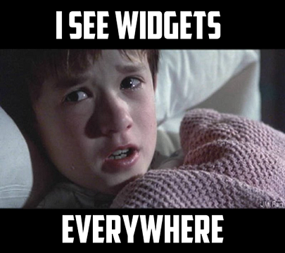
Summary
”Everything is a widget”
A page is just a bunch of nested widgets
Flutter is adopted widely across the industry

Slide 63
Flutter basics
Dart as its programming language

Slide 64

Dart
Flutter’s programming language

Slide 65
Dart
Flutter’s programming language
Developed by Google as a Frontend language

Slide 66
Dart
Flutter’s programming language
Developed by Google as a Frontend language
Inspired by Java & JavaScript

Slide 67
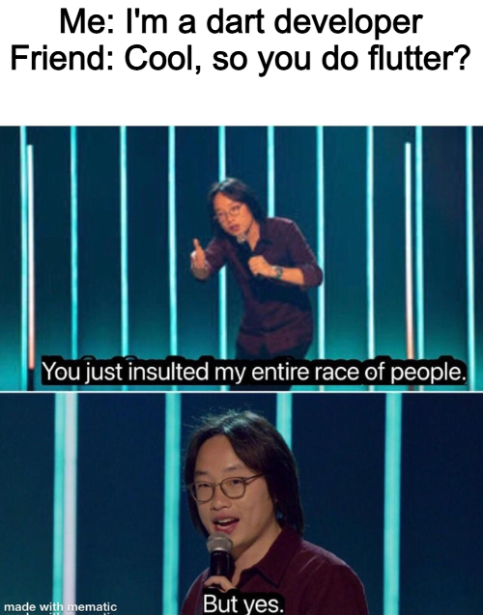
Dart
Flutter’s programming language
Developed by Google as a Frontend language
Inspired by Java & JavaScript
Notes:
Wird fast nur für Flutter genutzt

Slide 68
Dart
Flutter’s programming language
Developed by Google as a Frontend language
Inspired by Java & JavaScript
Supports incremental compilation => hot reload & hot restart

Slide 69
Dart
Flutter’s programming language
Developed by Google as a Frontend language
Inspired by Java & JavaScript
Supports incremental compilation => hot reload & hot restart
Performant due to Ahead of time (AoT) compilation to native code

Slide 70
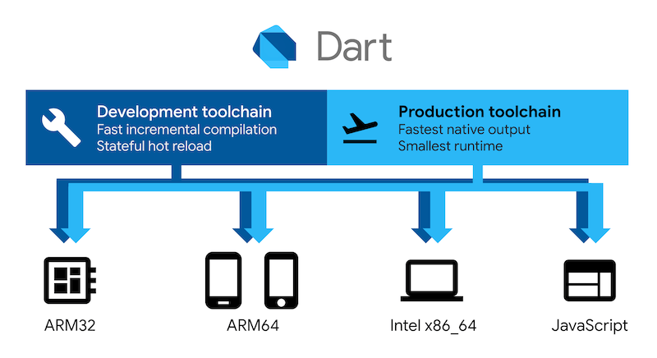
Dart

Slide 71
Flutter basics
Dart crash course

Slide 72
Built-in types

Slide 73
Built-in types
int integer = 42;

Slide 74
Built-in types
int integer = 42;
String string = 'This is a string';

Slide 75
Built-in types
int integer = 42;
String string = 'This is a string';
bool boolean = true || false;

Slide 76
Built-in types
int integer = 42;
String string = 'This is a string';
bool boolean = true || false;
double d = 3.1415;

Slide 77
Built-in types
int integer = 42;
String string = 'This is a string';
bool boolean = true || false;
double d = 3.1415;
List<int> numbers = [1, 2, 3, 4, 5];

Slide 78
Further built-in types
Record/Tuple
Set
Map
Null
Object
Void

Slide 79
Null safety

Slide 80
Null safety
int number = null;

Slide 81
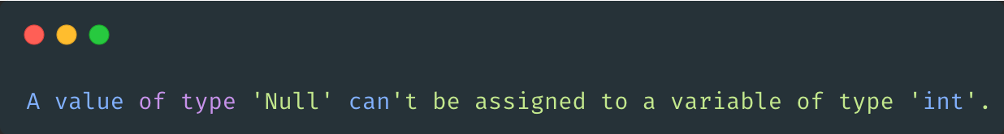
Null safety
int number = null;

Slide 82
Null safety
int? number = null;
Notes:
Sound!!!

Slide 83
Control flow

Slide 84
Control flow (conditional branching)
if(condition) { // do something } else if(anotherCondition) { // do something else } else { // do something else }

Slide 85
Control flow (while loop)
while (!isDone()) { doSomething(); }

Slide 86
Functions
bool isDone() { return true; }
while (!isDone()) { doSomething(); }

Slide 87
Functions
void doSomething() { print('Hello World!'); }
bool isDone() { return true; }
while (!isDone()) { doSomething(); }

Slide 88
Functions
bool isDone(int number) { return number == 3; }
int number = 0; while(!isDone(number)) { doSomething(); number++; }

Slide 89
Anonymous functions
void doSomething( void Function(int count) something, int count, ) { something(count); }
doSomething((count) { print('Hello World! $count'); }, number);

Slide 90
Control flow (for loop)
var message = StringBuffer('Dart is fun'); for (var i = 0; i < 5; i++) { message.write('!'); }

Slide 91
Control flow (enhanced for loop)
final participants = <Participant>[]; for (final participant in participants) { print('Hallo ${participant.name}!'); }

Slide 92
Classes
class Participant { final String name; Participant(this.name); }

Slide 93
Classes
class Participant { final String name; const Participant(this.name); }

Slide 94
Classes
class Participant { final String name; final int age; const Participant(this.age, { required this.name, }); }

Slide 95
Classes
class Participant { final String name; final int age; final String role; const Participant( this.age, { required this.name, this.role = 'member', }); }

Slide 96
Classes
class Participant { final String name; final int age; final String role; final String _password; const Participant( this.age, { required this.name, this.role = 'member', required String password, }) : _password = password; }

Slide 97
Classes
class Participant { final String name; final int age; final String role; final String _password; const Participant( this.age, { required this.name, this.role = 'member', required String password, }) : _password = password; void greet() { print('Hello $name!'); } }

Slide 98
Classes
const participant = Participant( 19, name: 'Julian Hartl', password: 'mysecretpassword', ); participant.greet();

Slide 99
Summary
Very Java/JavaScript like language
Easy to pick up
Lots of modern features

Slide 100
Shopping list app
Demo
Notes:
iPad herumgeben!!!

Slide 101
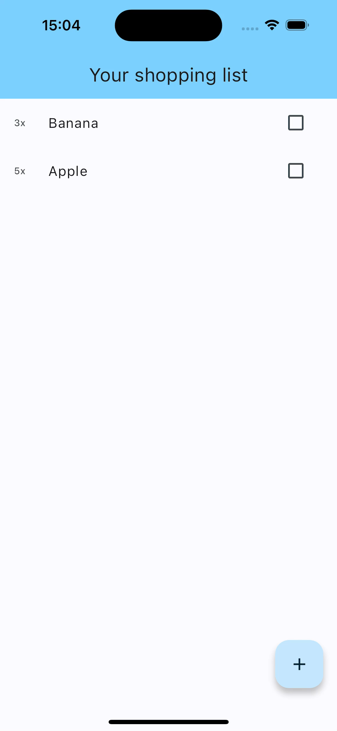

Slide 102
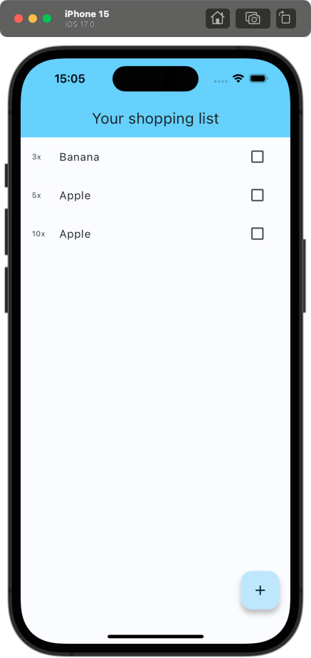
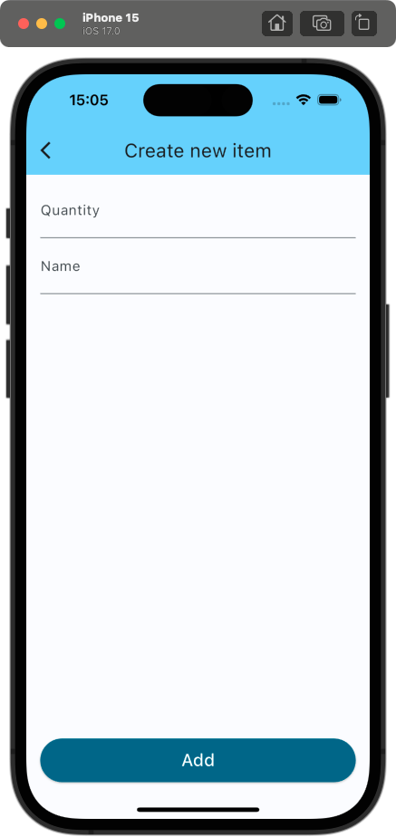

Slide 103
Shopping list app
“Live”-Coding

Slide 104


Slide 106
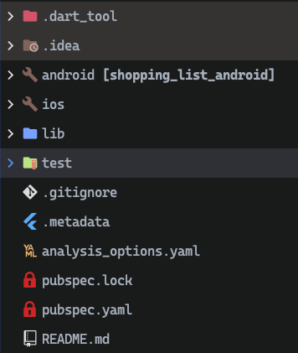

Slide 107
👈 “The .dart_tool directory, which is new in Dart 2, is used by pub and other tools.“
👈 Code specific to the operating systems
👈 Actual Flutter related code
👈 Here go your tests 😜
👈 Linter configuration
👈 Dependencies lock file (similar to yarn.lock or package-json.lock)
👈 Dependencies, assets, project configuration

Slide 108
pubspec.yaml
Project configuration

Slide 109

name: shopping_list description: A new Flutter project. publish_to: 'none' version: 1.0.0+1 environment: sdk: '>=3.1.3 <4.0.0' dependencies: flutter: sdk: flutter cupertino_icons: ^1.0.2 dev_dependencies: flutter_test: sdk: flutter flutter_lints: ^2.0.0

Slide 110
name: shopping_list description: A new Flutter project. publish_to: 'none' version: 1.0.0+1 environment: sdk: '>=3.1.3 <4.0.0' dependencies: flutter: sdk: flutter cupertino_icons: ^1.0.2 dev_dependencies: flutter_test: sdk: flutter flutter_lints: ^2.0.0
👈 Project configuration

Slide 111
name: shopping_list description: A new Flutter project. publish_to: 'none' version: 1.0.0+1 environment: sdk: '>=3.1.3 <4.0.0' dependencies: flutter: sdk: flutter cupertino_icons: ^1.0.2 dev_dependencies: flutter_test: sdk: flutter flutter_lints: ^2.0.0
👈 Project configuration
👈 Version + build number

Slide 112
name: shopping_list description: A new Flutter project. publish_to: 'none' version: 1.0.0+1 environment: sdk: '>=3.1.3 <4.0.0' dependencies: flutter: sdk: flutter cupertino_icons: ^1.0.2 dev_dependencies: flutter_test: sdk: flutter flutter_lints: ^2.0.0
👈 Project configuration
👈 Version + build number
👈 Supported dart versions

Slide 113
name: shopping_list description: A new Flutter project. publish_to: 'none' version: 1.0.0+1 environment: sdk: '>=3.1.3 <4.0.0' dependencies: flutter: sdk: flutter cupertino_icons: ^1.0.2 dev_dependencies: flutter_test: sdk: flutter flutter_lints: ^2.0.0
👈 Project configuration
👈 Version + build number
👈 Supported dart versions
👈 Any packages which are included in the bundled app

Slide 114
name: shopping_list description: A new Flutter project. publish_to: 'none' version: 1.0.0+1 environment: sdk: '>=3.1.3 <4.0.0' dependencies: flutter: sdk: flutter cupertino_icons: ^1.0.2 dev_dependencies: flutter_test: sdk: flutter flutter_lints: ^2.0.0
👈 Project configuration
👈 Version + build number
👈 Supported dart versions
👈 Any packages which are included in the bundled app
👈 Any packages that are needed during development, but should not be bundled in the final app

Slide 115
flutter: uses-material-design: true assets: - images/a_dot_burr.jpeg - images/a_dot_ham.jpeg fonts: - family: Schyler fonts: - asset: fonts/Schyler-Regular.ttf - asset: fonts/Schyler-Italic.ttf style: italic - family: Trajan Pro fonts: - asset: fonts/TrajanPro.ttf - asset: fonts/TrajanPro_Bold.ttf weight: 700
Notes:
Konfigurationen die mit Flutter zu tun haben

Slide 116
flutter: uses-material-design: true assets: - images/a_dot_burr.jpeg - images/a_dot_ham.jpeg fonts: - family: Schyler fonts: - asset: fonts/Schyler-Regular.ttf - asset: fonts/Schyler-Italic.ttf style: italic - family: Trajan Pro fonts: - asset: fonts/TrajanPro.ttf - asset: fonts/TrajanPro_Bold.ttf weight: 700
👈 Here you can define any assets, that should be included in the bundled app

Slide 117
flutter: uses-material-design: true assets: - images/a_dot_burr.jpeg - images/a_dot_ham.jpeg fonts: - family: Schyler fonts: - asset: fonts/Schyler-Regular.ttf - asset: fonts/Schyler-Italic.ttf style: italic - family: Trajan Pro fonts: - asset: fonts/TrajanPro.ttf - asset: fonts/TrajanPro_Bold.ttf weight: 700
👈 Any assets, that should be included in the bundled app
👈 Definition of customs fonts

Slide 118
pub
The package manager

Slide 119
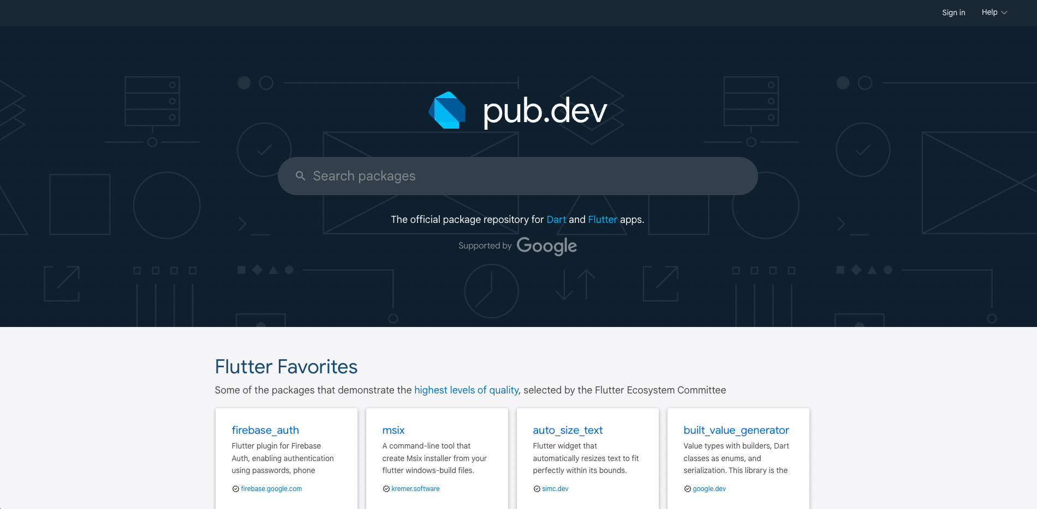
pub.dev

Slide 120
Adding a package
1. Search for a package

Slide 121
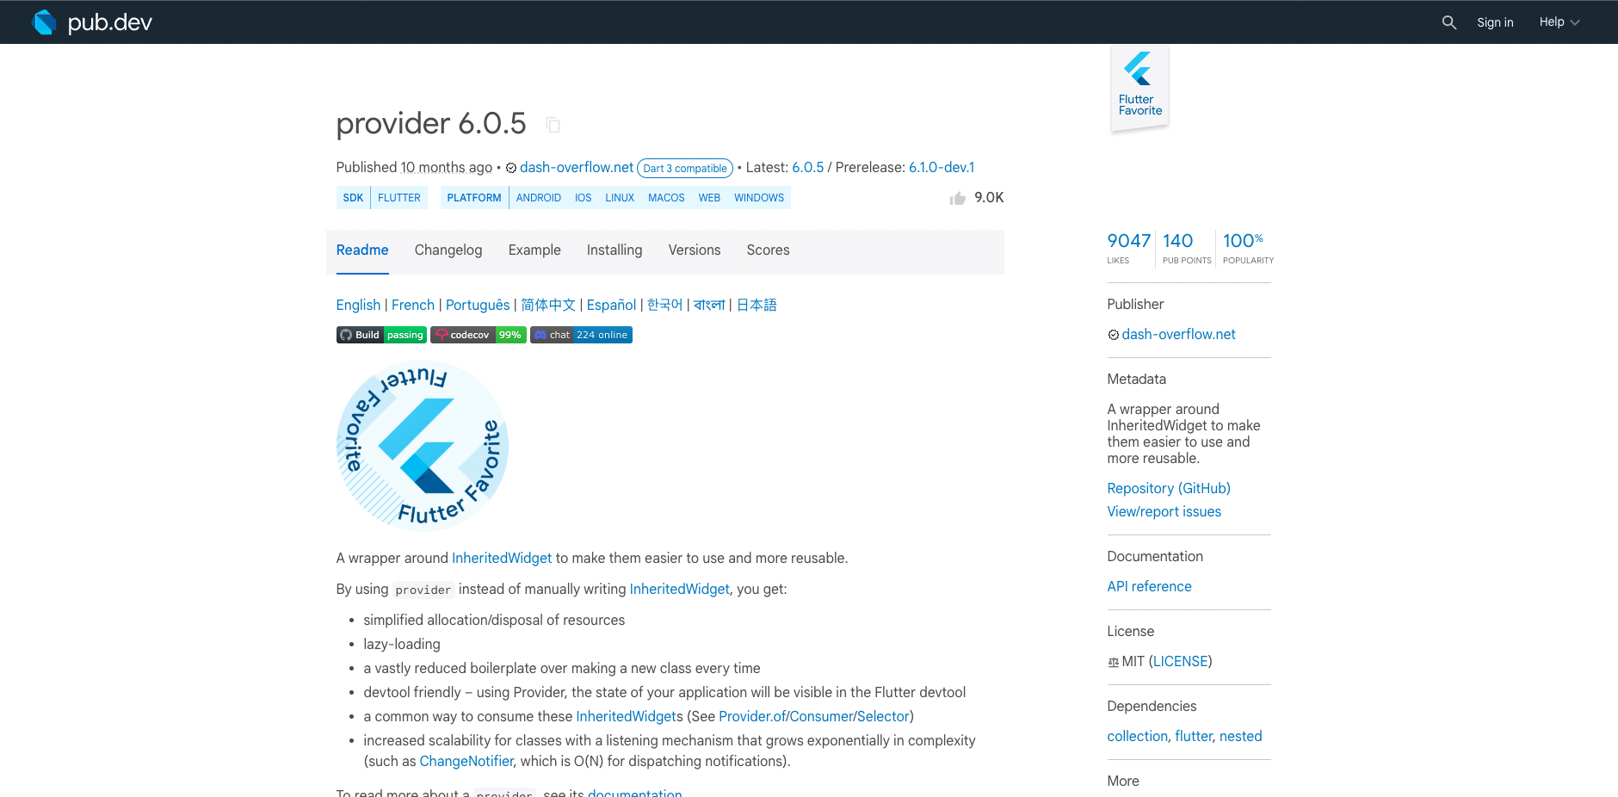
Searching for a package

Slide 122
Adding a package
Search for a package
Add the package to the project

Slide 123
Adding package to project
👈 Click here to copy package: version

Slide 124
Adding package to project
dependencies: flutter: sdk: flutter cupertino_icons: ^1.0.2

Slide 125
Adding package to project
dependencies: flutter: sdk: flutter cupertino_icons: ^1.0.2 provider: ^6.0.5

Slide 126
Adding package to project

Slide 127
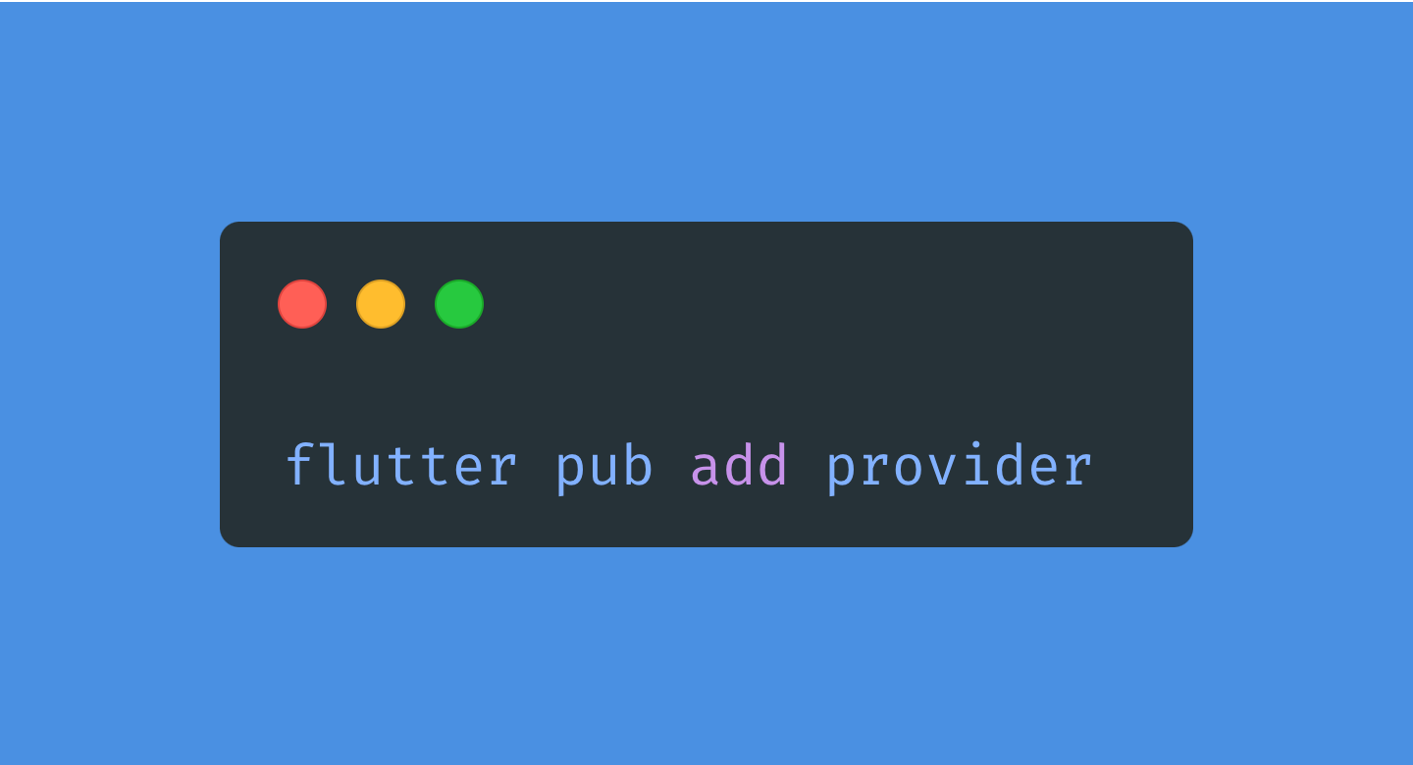
Adding package to project

Slide 128
Adding a package
Search for a package
Add the package to the project
Resolve & fetch dependencies

Slide 129
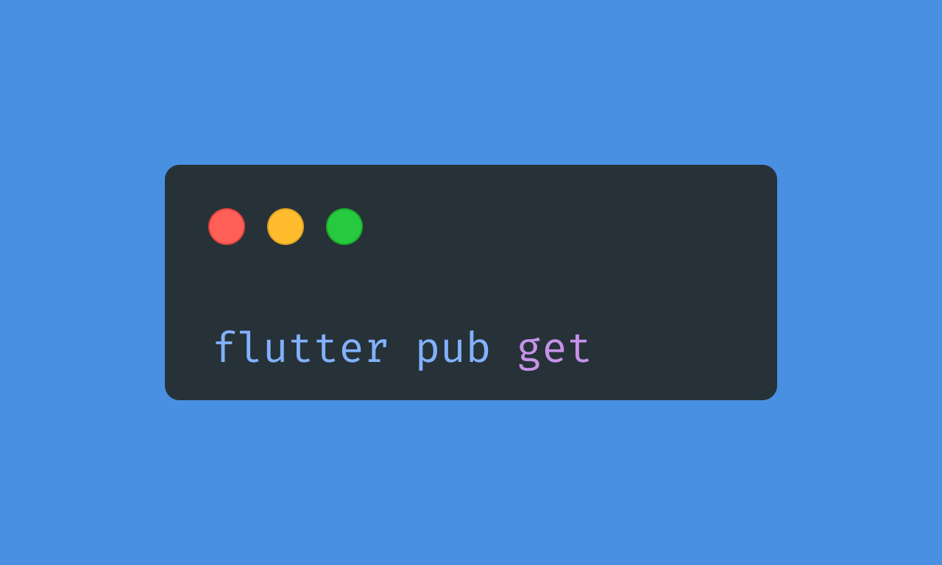
Resolving & fetching dependencies

Slide 130
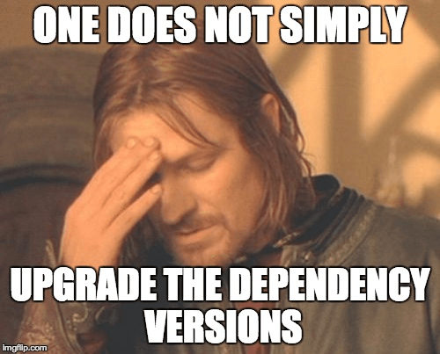

Slide 131
Shopping list app
Getting started

Slide 132
import 'package:flutter/material.dart'; void main() { runApp(const MyApp()); } class MyApp extends StatelessWidget { const MyApp({super.key}); @override Widget build(BuildContext context) { return MaterialApp( title: 'Flutter Demo', theme: ThemeData( colorScheme: ColorScheme.fromSeed(seedColor: Colors.deepPurple), useMaterial3: true, ), home: const MyHomePage(title: 'Flutter Demo Home Page'), ); } }

Slide 133
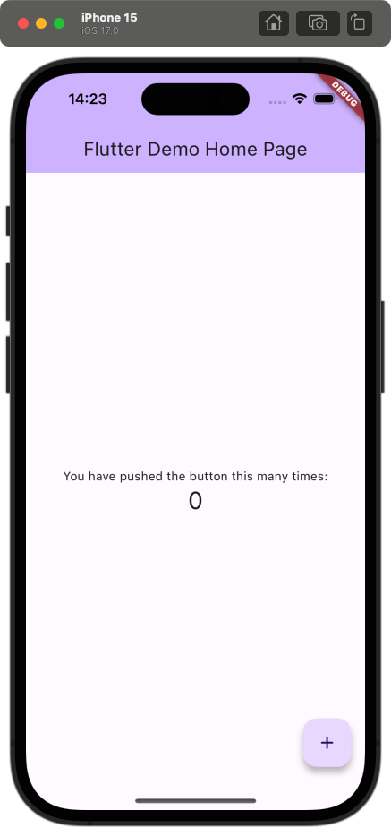
import 'package:flutter/material.dart'; void main() { runApp(const MyApp()); } class MyApp extends StatelessWidget { const MyApp({super.key}); @override Widget build(BuildContext context) { return MaterialApp( title: 'Flutter Demo', theme: ThemeData( colorScheme: ColorScheme.fromSeed(seedColor: Colors.deepPurple), useMaterial3: true, ), home: const MyHomePage(title: 'Flutter Demo Home Page'), ); } }

Slide 134
import 'package:flutter/material.dart'; void main() { runApp(const MyApp()); } class MyApp extends StatelessWidget { const MyApp({super.key}); @override Widget build(BuildContext context) { return MaterialApp( title: 'Flutter Demo', theme: ThemeData( colorScheme: ColorScheme.fromSeed(seedColor: Colors.deepPurple), useMaterial3: true, ), home: const MyHomePage(title: 'Flutter Demo Home Page'), ); } }

Slide 135
import 'package:flutter/material.dart'; void main() { runApp(const MyApp()); } class MyApp extends StatelessWidget { const MyApp({super.key}); @override Widget build(BuildContext context) { return MaterialApp( title: 'Flutter Demo', theme: ThemeData( colorScheme: ColorScheme.fromSeed(seedColor: Colors.deepPurple), useMaterial3: true, ), home: const MyHomePage(title: 'Flutter Demo Home Page'), ); } }
👈 Gives access to prebuilt widgets according to Material-UI Guidelines

Slide 136
import 'package:flutter/material.dart'; void main() { runApp(const MyApp()); } class MyApp extends StatelessWidget { const MyApp({super.key}); @override Widget build(BuildContext context) { return MaterialApp( title: 'Flutter Demo', theme: ThemeData( colorScheme: ColorScheme.fromSeed(seedColor: Colors.deepPurple), useMaterial3: true, ), home: const MyHomePage(title: 'Flutter Demo Home Page'), ); } }
👈 Gives access to prebuilt widgets according to Material-UI Guidelines
👈 Entry point of the application

Slide 137
import 'package:flutter/material.dart'; void main() { runApp(const MyApp()); } class MyApp extends StatelessWidget { const MyApp({super.key}); @override Widget build(BuildContext context) { return MaterialApp( title: 'Flutter Demo', theme: ThemeData( colorScheme: ColorScheme.fromSeed(seedColor: Colors.deepPurple), useMaterial3: true, ), home: const MyHomePage(title: 'Flutter Demo Home Page'), ); } }
👈 Gives access to prebuilt widgets according to Material-UI Guidelines
👈 Entry point of the application
👈 Extending from StatelessWidget to define a stateless widget

Slide 138
import 'package:flutter/material.dart'; void main() { runApp(const MyApp()); } class MyApp extends StatelessWidget { const MyApp({super.key}); @override Widget build(BuildContext context) { return MaterialApp( title: 'Flutter Demo', theme: ThemeData( colorScheme: ColorScheme.fromSeed(seedColor: Colors.deepPurple), useMaterial3: true, ), home: const MyHomePage(title: 'Flutter Demo Home Page'), ); } }
👈 Gives access to prebuilt widgets according to Material-UI Guidelines
👈 Entry point of the application
👈 Extending from StatelessWidget to define a stateless widget
👈 What is this?

Slide 139

MaterialApp
“A convenience widget that wraps a number of widgets that are commonly required for Material Design applications. It builds upon a WidgetsApp by adding material-design specific functionality […]“

Slide 140
Types of apps
MaterialApp
CupertinoApp
WidgetsApp
Provides styles to material widgets according to the Material design language for iOS, Android and web
Most commonly used
Provides styles to cupertino widgets based on Apple‘s Human Interface Guidelines
Used to build standard iOS-styled apps
Basis for the other two apps
Rarely to never used by actual Flutter developers

Slide 141
class MyApp extends StatelessWidget { const MyApp({super.key}); @override Widget build(BuildContext context) { return MaterialApp( title: 'Flutter Demo', theme: ThemeData( colorScheme: ColorScheme.fromSeed(seedColor: Colors.deepPurple), useMaterial3: true, ), home: const MyHomePage(title: 'Flutter Demo Home Page'), ); } }

Slide 142
class MyApp extends StatelessWidget { const MyApp({super.key}); @override Widget build(BuildContext context) { return MaterialApp( title: 'Flutter Demo', theme: ThemeData( colorScheme: ColorScheme.fromSeed(seedColor: Colors.deepPurple), useMaterial3: true, ), home: const MyHomePage(title: 'Flutter Demo Home Page'), ); } }
👈 Defines the theme of the application

Slide 143
class MyApp extends StatelessWidget { const MyApp({super.key}); @override Widget build(BuildContext context) { return MaterialApp( title: 'Flutter Demo', theme: ThemeData( colorScheme: ColorScheme.fromSeed(seedColor: Colors.deepPurple), useMaterial3: true, ), home: const MyHomePage(title: 'Flutter Demo Home Page'), ); } }
👈 Defines the theme of the application
👆Defines the page that is initially rendered

Slide 144
class MyApp extends StatelessWidget { const MyApp({super.key}); @override Widget build(BuildContext context) { return MaterialApp( title: 'Flutter Demo', theme: ThemeData( colorScheme: ColorScheme.fromSeed( seedColor: const Color( 0xff38bdf8, ), ), useMaterial3: true, ), home: const MyHomePage(title: 'Flutter Demo Home Page'), ); } }
👈 Custom hex color prefixed with 0xff

Slide 145
class MyApp extends StatelessWidget { const MyApp({super.key}); @override Widget build(BuildContext context) { return MaterialApp( title: 'Shopping list', theme: ThemeData( colorScheme: ColorScheme.fromSeed( seedColor: const Color( 0xff38bdf8, ), ), useMaterial3: true, ), home: const MyHomePage(title: 'Your shopping list'), ); } }

Slide 146
How do I run the app?
Using the flutter cli

Slide 147
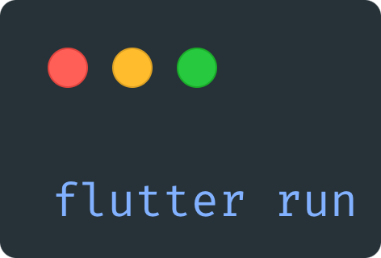
Running the app
Looks for any connected device (simulators, physical devices, …)
When started, type “r“ to hot reload and “R“ to hot restart

Slide 148
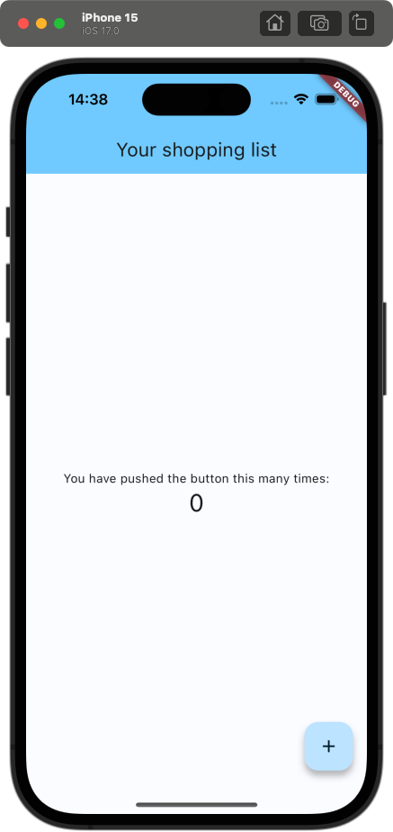
lib/main.dart
class MyApp extends StatelessWidget { const MyApp({super.key}); @override Widget build(BuildContext context) { return MaterialApp( title: 'Shopping list', theme: ThemeData( colorScheme: ColorScheme.fromSeed( seedColor: const Color( 0xff38bdf8, ), ), useMaterial3: true, ), home: const MyHomePage(title: 'Your shopping list'), ); } }

Slide 149
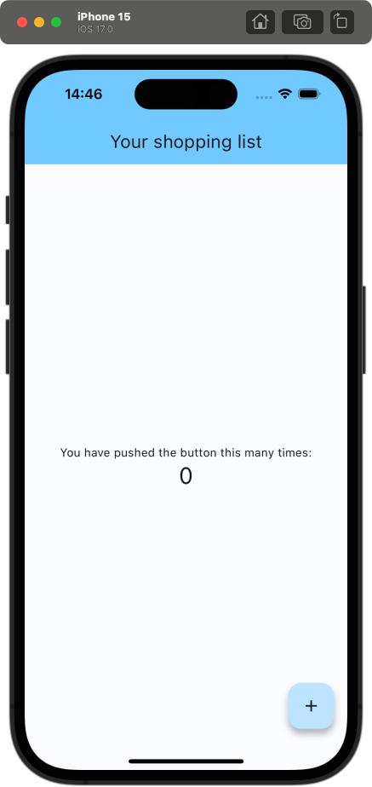
lib/main.dart
class MyApp extends StatelessWidget { const MyApp({super.key}); @override Widget build(BuildContext context) { return MaterialApp( title: 'Shopping list', debugShowCheckedModeBanner: false, theme: ThemeData( colorScheme: ColorScheme.fromSeed( seedColor: const Color( 0xff38bdf8, ), ), useMaterial3: true, ), home: const MyHomePage(title: 'Your shopping list'), ); } }
👆 Hide DEBUG banner

Slide 150
Shopping list app
Creating the first page

Slide 151
lib/main.dart
class MyHomePage extends StatelessWidget { const MyHomePage({super.key}); @override Widget build(BuildContext context) { return const Placeholder(); } }
Notes:
Das sieht ja jetzt erstmal nach recht viel Boilerplate aus => Lösung: Alle IDEs bieten Live-Templates, um diesen Boilerplate zu erstellen

Slide 152
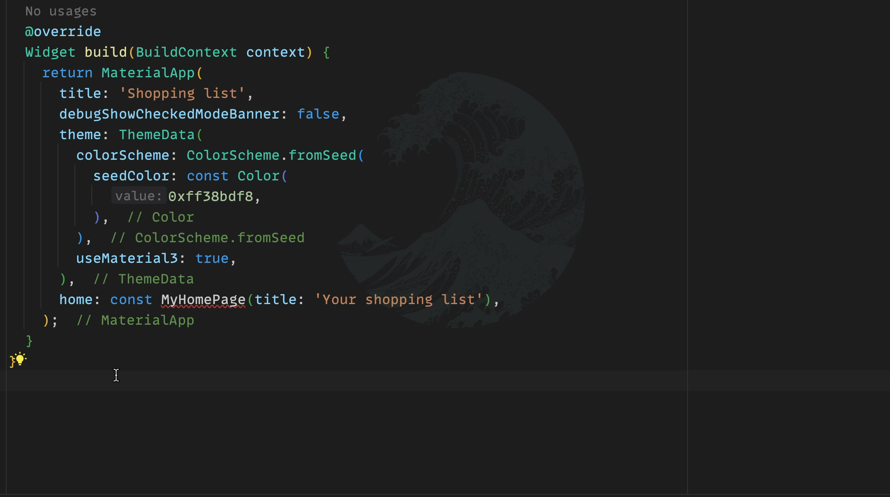
lib/main.dart
class MyHomePage extends StatelessWidget { const MyHomePage({super.key}); @override Widget build(BuildContext context) { return const Placeholder(); } }

Slide 153
lib/main.dart
class MyHomePage extends StatelessWidget { const MyHomePage({super.key}); @override Widget build(BuildContext context) { return const Placeholder(); } }

Slide 154
lib/main.dart
class MyHomePage extends StatelessWidget { const MyHomePage({super.key, required this.title}); final String title; @override Widget build(BuildContext context) { return const Placeholder(); } }

Slide 155
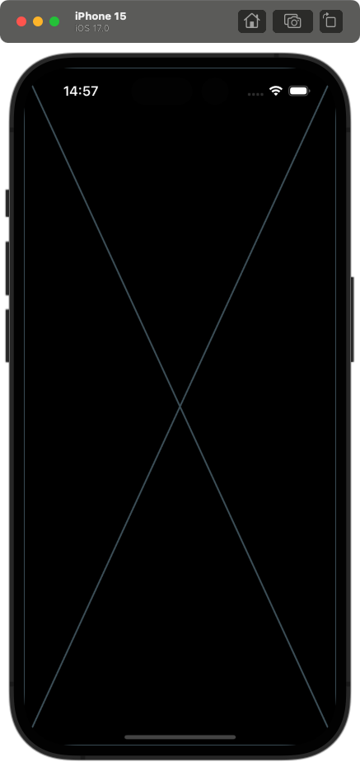
class MyHomePage extends StatelessWidget { const MyHomePage({super.key, required this.title}); final String title; @override Widget build(BuildContext context) { return const Placeholder(); } }
Notes:
Wir brauchen nun ein wenig Struktur (oder eine Art Baugerüst) auf der Seite => Perfekter Startpunkt: Scaffold

Slide 156
Scaffold
“Implements the basic Material Design visual layout structure.“

Slide 157
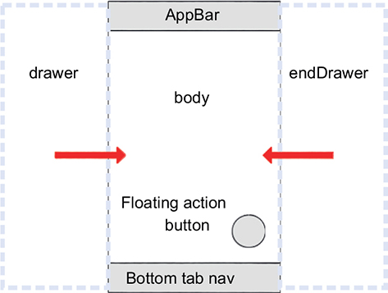
Scaffold
appBar: “An app bar to display at the top of the scaffold.“
body: “The primary content of the scaffold.“
floatingActionButton: “A button displayed floating above body, in the bottom right corner.“
backgroundColor: “The color of the Material widget that underlies the entire scaffold.“
see all properties here
Notes:
backgroundColor wird normalerweise über das Theme in der MaterialApp gesetzt => einheitliches Design

Slide 158
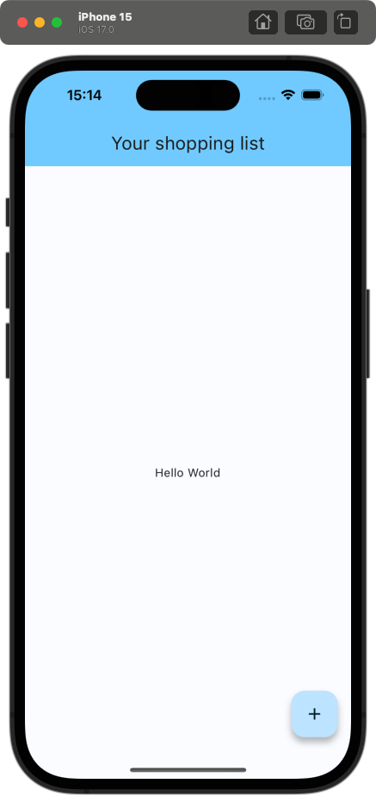
lib/main.dart
class MyHomePage extends StatelessWidget { const MyHomePage({super.key, required this.title}); final String title; @override Widget build(BuildContext context) { return Scaffold( appBar: AppBar( backgroundColor: Theme.of(context).colorScheme.inversePrimary, title: Text(title), ), body: const Center( child: Text('Hello World'), ), floatingActionButton: FloatingActionButton( onPressed: () {}, child: const Icon(Icons.add), ), ); } }

Slide 159
lib/main.dart
class MyHomePage extends StatelessWidget { const MyHomePage({super.key, required this.title}); final String title; @override Widget build(BuildContext context) { return Scaffold( appBar: AppBar( backgroundColor: Theme.of(context).colorScheme.inversePrimary, title: Text(title), ), body: const Center( child: Text('Hello World'), ), floatingActionButton: FloatingActionButton( onPressed: () {}, child: const Icon(Icons.add), ), ); } }

Slide 160
lib/main.dart
class MyHomePage extends StatelessWidget { const MyHomePage({super.key, required this.title}); final String title; @override Widget build(BuildContext context) { return Scaffold( appBar: AppBar( backgroundColor: Theme.of(context).colorScheme.inversePrimary, title: Text(title), ), body: const Center( child: Text('Hello World'), ), floatingActionButton: FloatingActionButton( onPressed: () {}, child: const Icon(Icons.add), ), ); } }

Slide 161
lib/main.dart
class MyHomePage extends StatelessWidget { const MyHomePage({super.key, required this.title}); final String title; @override Widget build(BuildContext context) { return Scaffold( appBar: AppBar( backgroundColor: Theme.of(context).colorScheme.inversePrimary, title: Text(title), ), body: const Center( child: Text('Hello World'), ), floatingActionButton: FloatingActionButton( onPressed: () {}, child: const Icon(Icons.add), ), ); } }

Slide 162
Center
“A widget that centers its child within itself.“

Slide 163

Center
“A widget that centers its child within itself.“
Notes:
Das macht Dinge in Flutter einiges angenehmer als z.B. mit CSS

Slide 164
AppBar
“A Material Design app bar.“

Slide 165
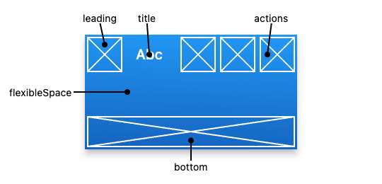
AppBar
title: “The primary widget displayed in the app bar.“
actions: “A list of Widgets to display in a row after the title widget.“
leading: “A widget to display before the toolbar‘s title.“
bottom: “This widget appears across the bottom of the app bar.“
see all properties here

Slide 166
lib/main.dart
class MyHomePage extends StatelessWidget { const MyHomePage({super.key, required this.title}); final String title; @override Widget build(BuildContext context) { return Scaffold( appBar: AppBar( backgroundColor: Theme.of(context).colorScheme.inversePrimary, title: Text(title), ), body: const Center( child: Text('Hello World'), ), floatingActionButton: FloatingActionButton( onPressed: () {}, child: const Icon(Icons.add), ), ); } }
Notes:
kurzer Moment Pause

Slide 167
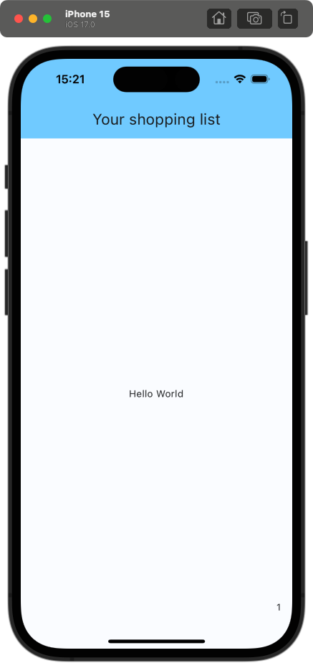
lib/main.dart
@override Widget build(BuildContext context) { return Scaffold( appBar: AppBar( backgroundColor: Theme.of(context).colorScheme.inversePrimary, title: Text(title), ), body: const Center( child: Text('Hello World'), ), floatingActionButton: const Text('1'), ); }
👆floatingActionButton is not of type FloatingActionButton, but Widget
Notes:
Everything is a widget

Slide 168
lib/main.dart
@override Widget build(BuildContext context) { return Scaffold( appBar: AppBar( backgroundColor: Theme.of(context).colorScheme.inversePrimary, title: Text(title), ), body: const Center( child: Text('Hello World'), ), floatingActionButton: FloatingActionButton( onPressed: () {}, child: const Icon(Icons.add), ), ); }

Slide 169
Shopping list app
Defining the models

Slide 170
lib/main.dart
class ShoppingList { final List<ShoppingListItem> items; ShoppingList() : items = []; }

Slide 171
lib/main.dart
class ShoppingList { final List<ShoppingListItem> items; ShoppingList() : items = []; } class ShoppingListItem { final int id; final String name; final int quantity; bool isBought; ShoppingListItem({ required this.id, required this.name, required this.quantity, required this.isBought, }); }

Slide 172
lib/main.dart
class ShoppingList { final List<ShoppingListItem> items; static int _nextId = 0; ShoppingList() : items = []; void addItem({ required String name, required int quantity, }) { items.add( ShoppingListItem( id: _nextId++, name: name, quantity: quantity, isBought: false, ), ); } }

Slide 173
Shopping list app
Creating the list of shopping list items

Slide 174
lib/main.dart
class ShoppingListView extends StatefulWidget { const ShoppingListView({super.key}); @override State<ShoppingListView> createState() => _ShoppingListViewState(); } class _ShoppingListViewState extends State<ShoppingListView> { @override Widget build(BuildContext context) { return const Placeholder(); } }
Notes:
So erstellt man ein StatefulWidget => auch hier gibt es ein Live-Template: anstatt stateless aber stful

Slide 175
lib/main.dart
class _ShoppingListViewState extends State<ShoppingListView> { ShoppingList _shoppingList = ShoppingList(); @override Widget build(BuildContext context) { return const Placeholder(); } }
Notes:
Wir wollen nun alle Items aus der ShoppingList anzeigen => wir brauchen einen Scrollable Container, da wir eine dynamische Anzahl an Items haben

Slide 176
ListView
“A scrollable list of widgets arranged linearly.“

Slide 177
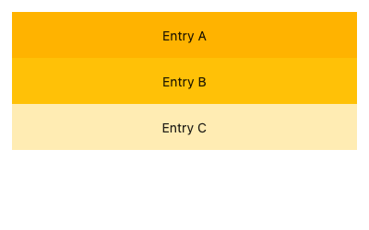
ListView
children: The widgets layed out along the main axis.
scrollDirection: “The axis along which the scroll view‘s offset increases.“
shrinkWrap: “Whether the extent of the scroll view in the scrollDirection should be determined by the contents being viewed.“
controller: “An object that can be used to control the position to which this scroll view is scrolled.“
see all properties here

Slide 178
lib/main.dart
class _ShoppingListViewState extends State<ShoppingListView> { ShoppingList _shoppingList = ShoppingList(); @override Widget build(BuildContext context) { return ListView( children: [], ); } }

Slide 179
lib/main.dart
class _ShoppingListViewState extends State<ShoppingListView> { ShoppingList _shoppingList = ShoppingList(); @override Widget build(BuildContext context) { return ListView( children: [ for (final item in _shoppingList.items) ListTile( leading: Text(item.id.toString()), title: Text(item.name), ) ], ); } }

Slide 180
ListTile
“A single fixed-height row that typically contains some text as well as a leading or trailing icon.“

Slide 181
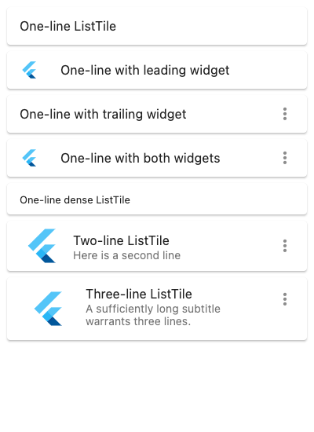
ListTile
title: “The primary content of the list tile.“
leading: “A widget to display before the title.“
trailing: “A widget to display after the title.“
subtitle: “Additional content displayed below the title.“
onTap: “Called when the user taps this list tile.“
see all properties here
Notes:
onTap aktiviert außerdem den Splash Effekt, wenn der Nutzer auf das Tile klickt

Slide 182
lib/main.dart
class _ShoppingListViewState extends State<ShoppingListView> { ShoppingList _shoppingList = ShoppingList(); @override Widget build(BuildContext context) { return ListView( children: [ for (final item in _shoppingList.items) ListTile( leading: Text(item.id.toString()), title: Text(item.name), ) ], ); } }

Slide 183

lib/main.dart
class MyHomePage extends StatelessWidget { const MyHomePage({super.key, required this.title}); final String title; @override Widget build(BuildContext context) { return Scaffold( appBar: AppBar( backgroundColor: Theme.of(context).colorScheme.inversePrimary, title: Text(title), ), body: const ShoppingListView(), floatingActionButton: FloatingActionButton( onPressed: () {}, child: const Icon(Icons.add), ), ); } }

Slide 184

lib/main.dart
class _ShoppingListViewState extends State<ShoppingListView> { ShoppingList _shoppingList = ShoppingList() ..addItem( name: 'Banana', quantity: 3, ); @override Widget build(BuildContext context) { return ListView( children: [ for (final item in _shoppingList.items) ListTile( leading: Text(item.id.toString()), title: Text(item.name), ) ], ); } }

Slide 185
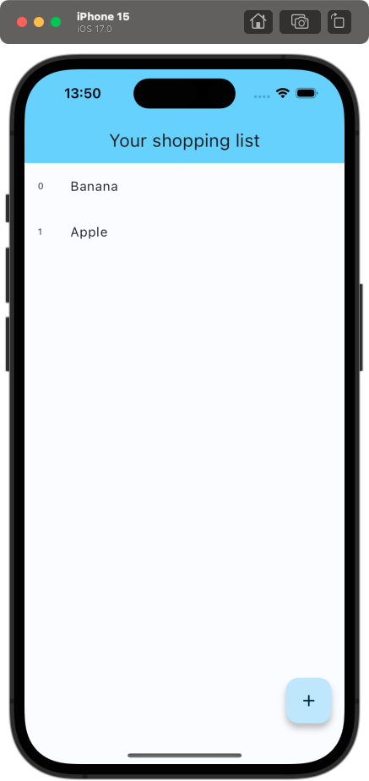
lib/main.dart
class _ShoppingListViewState extends State<ShoppingListView> { ShoppingList _shoppingList = ShoppingList() ..addItem( name: 'Banana', quantity: 3, )
..addItem( name: 'Apple‘, quantity: 5); @override Widget build(BuildContext context) { return ListView( children: [ for (final item in _shoppingList.items) ListTile( leading: Text(item.id.toString()), title: Text(item.name), ) ], ); } }

Slide 186
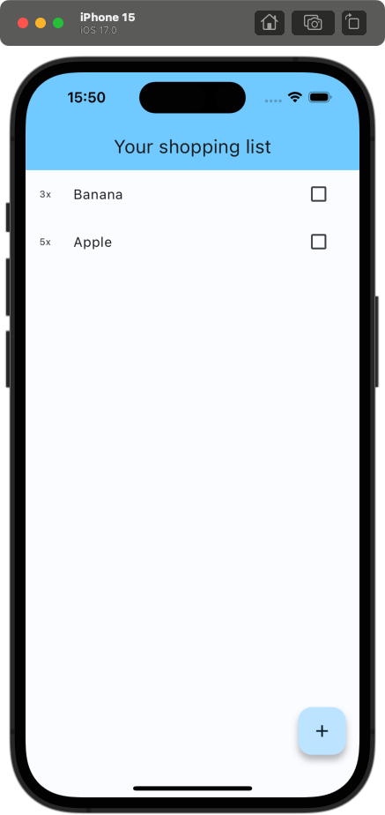
lib/main.dart
@override Widget build(BuildContext context) { return ListView( children: [ for (final item in _shoppingList.items) ListTile( leading: Text('${item.quantity}x'), title: Text(item.name), trailing: Checkbox( value: false, onChanged: (value) {}, ), ) ], ); }
Notes:
Checkbox hinzufügen und quantity anzeigen

Slide 187
CheckBox
“A Material Design checkbox.“

Slide 188
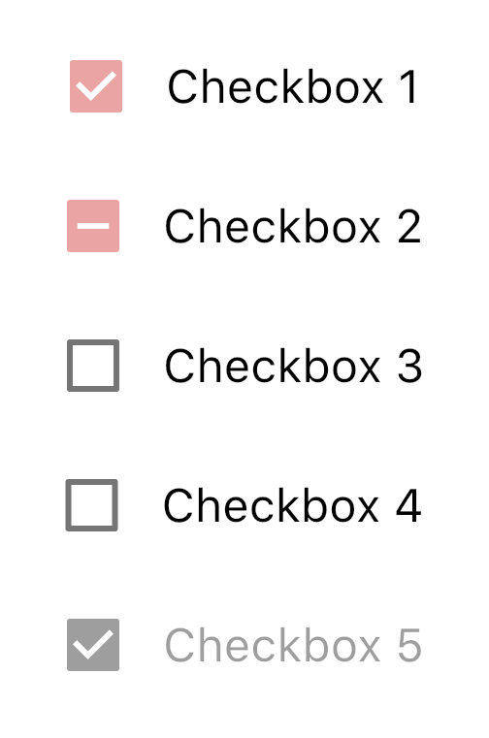
CheckBox
value: “Whether this checkbox is checked.“
onChanged: “Called when the value of the checkbox should change.“
see all properties here

Slide 189
lib/main.dart
@override Widget build(BuildContext context) { return ListView( children: [ for (final item in _shoppingList.items) ListTile( leading: Text('${item.quantity}x'), title: Text(item.name), trailing: Checkbox( value: false, onChanged: (value) {}, ), ) ], ); }

Slide 190
lib/main.dart
@override Widget build(BuildContext context) { return ListView( children: [ for (final item in _shoppingList.items) ListTile( leading: Text('${item.quantity}x'), title: Text(item.name), trailing: Checkbox( value: item.isBought, onChanged: (value) { item.isBought = value!; }, ), ) ], ); }
Notes:
Wir setzen value auf item.isBought, weil die Checkbox gecheckt sein soll, wenn das Item gekauft wurde. Wir updaten in onChange item.isBought.

Slide 191
lib/main.dart
@override Widget build(BuildContext context) { return ListView( children: [ for (final item in _shoppingList.items) ListTile( leading: Text('${item.quantity}x'), title: Text(item.name), trailing: Checkbox( value: item.isBought, onChanged: (value) { item.isBought = value!; }, ), ) ], ); }
Null assertion operator👆
Notes:
Das „!“ ist der Null assertion operator und castet den Wert zu einem nicht nullable Type => wirft eine Exception, falls der Wert null ist

Slide 192

lib/main.dart
class ShoppingList { void setBought(ShoppingListItem item, {required bool bought}) { for (int index = 0; index < _items.length; index++) { if (_items[index].id == item.id) { _items[index] = _items[index].copyWith(isBought: bought); return; } } }
}
class ShoppingListItem { ShoppingListItem copyWith({bool? isBought}) { return ShoppingListItem( id: id, name: name, quantity: quantity, isBought: isBought ?? this.isBought, ); }
}
Notes:
Warum wird nicht neu gerendert? Muss man eventuell der _shoppingList Variable eine neue Instanz zuweisen, wie z.B. mit useState in React? Nein, man muss setState aufrufen!

Slide 193
Shopping list app
Simple state management

Slide 194
lib/main.dart
@override Widget build(BuildContext context) { return ListView( children: [ for (final item in _shoppingList.items) ListTile( leading: Text('${item.quantity}x'), title: Text(item.name), trailing: Checkbox( value: item.isBought, onChanged: (value) { item.isBought = value!; }, ), ) ], ); }
Notes:
Das „Problem“ ist, dass Flutter nicht automatisch updated, wenn sich ein State-Object ändert. Anstattdessen müssen wir als Entwickler explizit festlegen, wann wir das Widget neu rendern wollen

Slide 195
lib/main.dart
@override Widget build(BuildContext context) { return ListView( children: [ for (final item in _shoppingList.items) ListTile( leading: Text('${item.quantity}x'), title: Text(item.name), trailing: Checkbox( value: item.isBought, onChanged: (value) { item.isBought = value!; }, ), ) ], ); }
👆We have to tell Flutter that the state changed

Slide 196
lib/main.dart
@override Widget build(BuildContext context) { return ListView( children: [ for (final item in _shoppingList.items) ListTile( leading: Text('${item.quantity}x'), title: Text(item.name), trailing: Checkbox( value: item.isBought, onChanged: (value) { setState(() { item.isBought = value!;
}); }, ), ) ], ); }
👆setState rerenders the whole widget sub tree
Notes:
Wir machen das, indem wir setState benutzen! setState wird bereitgestellt durch die Oberklasse „State“

Slide 197

lib/main.dart
@override Widget build(BuildContext context) { return ListView( children: [ for (final item in _shoppingList.items) ListTile( leading: Text('${item.quantity}x'), title: Text(item.name), trailing: Checkbox( value: item.isBought, onChanged: (value) { setState(() { item.isBought = value!;
}); }, ), ) ], ); }

Slide 198
lib/main.dart
@override Widget build(BuildContext context) { return ListView( children: [ for (final item in _shoppingList.items) ListTile( leading: Text('${item.quantity}x'), title: Text(item.name), trailing: Checkbox( value: item.isBought, onChanged: (value) { setState(() { item.isBought = value!;
}); }, ), ) ], ); }

Slide 199
Shopping list app
Using the onTap Property of ListTile
Notes:
Wäre cool, wenn wir bei einem Klick auf das ListTile die CheckBox updaten könnten

Slide 200
lib/main.dart
@override Widget build(BuildContext context) { return ListView( children: [ for (final item in _shoppingList.items) ListTile( leading: Text('${item.quantity}x'), title: Text(item.name), trailing: Checkbox( value: item.isBought, onChanged: (value) { setState(() { item.isBought = value!;
}); }, ), ) ], ); }

Slide 201
lib/main.dart
ListTile( onTap: () { setState(() { item.isBought = !item.isBought; }); }, leading: Text('${item.quantity}x'), title: Text(item.name), trailing: Checkbox( value: item.isBought, onChanged: (value) { setState(() { item.isBought = value!;
}); }, ), )
Notes:
Wir benutzen die onTap Property vom ListTile Widget => allerdings duplizierter Code => extrahieren in eine Helfer-Methode

Slide 202
lib/main.dart
ListTile( onTap: () { setState(() { item.isBought = !item.isBought; }); }, leading: Text('${item.quantity}x'), title: Text(item.name), trailing: Checkbox( value: item.isBought, onChanged: (value) { setState(() { item.isBought = value!;
}); }, ), )
Duplicated code
Notes:
Wir benutzen die onTap Property vom ListTile Widget => allerdings duplizierter Code => extrahieren in eine Helfer-Methode

Slide 203
lib/main.dart
void _toggleBought(ShoppingListItem item) { setState(() { item.isBought = !item.isBought; }); }
Notes:
Diese lebt auch in der State Klasse

Slide 204
lib/main.dart
ListTile( onTap: () { setState(() { item.isBought = !item.isBought; }); }, leading: Text('${item.quantity}x'), title: Text(item.name), trailing: Checkbox( value: item.isBought, onChanged: (value) { setState(() { item.isBought = value!;
}); }, ), )

Slide 205
lib/main.dart
ListTile( onTap: () { _toggleBought(item); }, leading: Text('${item.quantity}x'), title: Text(item.name), trailing: Checkbox( value: item.isBought, onChanged: (_) { _toggleBought(item); }, ), )
Notes:
Benutzen der Helfer-Methode _toggleBought

Slide 206
Shopping list app
Reflecting on current issues

Slide 207
lib/main.dart
@override Widget build(BuildContext context) { return ListView( children: [ for (final item in _shoppingList.items) ListTile( onTap: () { _toggleBought(item); }, leading: Text('${item.quantity}x'), title: Text(item.name), trailing: Checkbox( value: item.isBought, onChanged: (_) { _toggleBought(item); }, ), ) ], ); }
Notes:
Aktuell mehrere Probleme:
- Bei jedem Call von _toggleBought werden alle ListTiles neu gerendert => Wir wollen aber nur das spezifische ListTile updaten => State im Tree nach unten ziehen
- Bei vielen Items in der ShoppingList werden alle ListTiles auf einmal gerendert => Nur die ListTiles rendern, die auch in View sind => Lazy Rendering

Slide 208
lib/main.dart
@override Widget build(BuildContext context) { return ListView( children: [ for (final item in _shoppingList.items) ListTile( onTap: () { _toggleBought(item); }, leading: Text('${item.quantity}x'), title: Text(item.name), trailing: Checkbox( value: item.isBought, onChanged: (_) { _toggleBought(item); }, ), ) ], ); }
👆 rerenders the whole widget sub tree
Notes:
Aktuell mehrere Probleme:
- Bei jedem Call von _toggleBought werden alle ListTiles neu gerendert => Wir wollen aber nur das spezifische ListTile updaten => State im Tree nach unten ziehen
- Bei vielen Items in der ShoppingList werden alle ListTiles auf einmal gerendert => Nur die ListTiles rendern, die auch in View sind => Lazy Rendering

Slide 209
lib/main.dart
@override Widget build(BuildContext context) { return ListView( children: [ for (final item in _shoppingList.items) ListTile( onTap: () { _toggleBought(item); }, leading: Text('${item.quantity}x'), title: Text(item.name), trailing: Checkbox( value: item.isBought, onChanged: (_) { _toggleBought(item); }, ), ) ], ); }
👆 renders all items at once
👆 rerenders the whole widget sub tree
Notes:
Aktuell mehrere Probleme:
- Bei jedem Call von _toggleBought werden alle ListTiles neu gerendert => Wir wollen aber nur das spezifische ListTile updaten => State im Tree nach unten ziehen
- Bei vielen Items in der ShoppingList werden alle ListTiles auf einmal gerendert => Nur die ListTiles rendern, die auch in View sind => Lazy Rendering

Slide 210
Shopping list app
Why does setState rerender every ListTile?
Notes:
Wäre cool, wenn wir bei einem Klick auf das ListTile die CheckBox updaten könnten

Slide 211
ShoppingListView
…
ListView
ListTile
ListTile
…
ListTile

Slide 212
ShoppingListView
_shoppingList.items
…
ListView
ListTile
ListTile
…
ListTile

Slide 213
ShoppingListView
_shoppingList.items
setState()
…
ListView
ListTile
ListTile
…
ListTile

Slide 214
ShoppingListView
_shoppingList.items
setState()
…
ListView
ListTile
ListTile
…
ListTile

Slide 215
ShoppingListView
_shoppingList.items
setState()
…
ListView
ListTile
ListTile
…
ListTile

Slide 216
ShoppingListView
_shoppingList.items
setState()
…
ListView
ListTile
ListTile
…
ListTile

Slide 217
Shopping list app
Solution: Lowering state

Slide 218
ShoppingListView
_shoppingList.items
…
ListView
ListTile
ListTile
…
ListTile
Notes:
Anstatt, dass die items in der ShoppingListView selbst leben, …

Slide 219
ShoppingListView
…
ListView
_ShoppingListItemTile
item
_ShoppingListItemTile
item
_ShoppingListItemTile
item
Notes:
… leben sie jetzt in den ListTiles selbst. Dafür müssen wir ein neues stateful Widget erstellen

Slide 220
ShoppingListView
…
ListView
_ShoppingListItemTile
item
_ShoppingListItemTile
item
_ShoppingListItemTile
item
setState()
Notes:
Wenn wir nun setState in einem dieser Widgets aufrufen, …

Slide 221
ShoppingListView
…
ListView
_ShoppingListItemTile
item
_ShoppingListItemTile
item
_ShoppingListItemTile
item
setState()
Notes:
… wird nur das eigentlich ListTile rerendert

Slide 222
Shopping list app
Implementing the solution

Slide 223
lib/main.dart
class _ShoppingListItemTile extends StatefulWidget { const _ShoppingListItemTile({ required this.item, super.key, }); final ShoppingListItem item; @override State<_ShoppingListItemTile> createState() => _ShoppingListItemTileState(); }
class _ShoppingListItemTileState extends State<_ShoppingListItemTile> { @override Widget build(BuildContext context) { return const Placeholder(); } }

Slide 224
lib/main.dart
class _ShoppingListItemTileState extends State<_ShoppingListItemTile> { @override Widget build(BuildContext context) { return ListTile( onTap: () { _toggleBought(item); }, leading: Text('${item.quantity}x'), title: Text(item.name), trailing: Checkbox( value: item.isBought, onChanged: (value) { _toggleBought(item); }, ), ); } }
Notes:
ListTile Definition vom alten Widget ins neue kopieren => allerdings ist z.B. _toggleBought und item undefiniert

Slide 225
lib/main.dart
class _ShoppingListItemTileState extends State<_ShoppingListItemTile> { ShoppingListItem get item => widget.item; @override Widget build(BuildContext context) { return ListTile( onTap: () { _toggleBought(item); }, leading: Text('${item.quantity}x'), title: Text(item.name), trailing: Checkbox( value: item.isBought, onChanged: (value) { _toggleBought(item); }, ), ); } }
👆 access properties of StatefulWidget via widget.
Notes:
Auf item über widget.item zugreifen

Slide 226
lib/main.dart
ShoppingListItem get item => widget.item; void _toggleBought() { setState(() { item.isBought = !item.isBought; }); } @override Widget build(BuildContext context) { return ListTile( onTap: () { _toggleBought(); }, leading: Text('${item.quantity}x'), title: Text(item.name), trailing: Checkbox( value: item.isBought, onChanged: (value) { _toggleBought(); }, ), ); }
Notes:
_toggleBought anpassen (Parameter entfernen)

Slide 227
lib/main.dart
ShoppingListItem get item => widget.item; void _toggleBought() { setState(() { item.isBought = !item.isBought; }); } @override Widget build(BuildContext context) { return ListTile( onTap: _toggleBought, leading: Text('${item.quantity}x'), title: Text(item.name), trailing: Checkbox( value: item.isBought, onChanged: (_) { _toggleBought(); }, ), ); }
Notes:
onTap in ListTile direkt zu Referenz auf _toggleBought setzen

Slide 228
lib/main.dart
void _toggleBought(ShoppingListItem item) { setState(() { item.isBought = !item.isBought; }); } @override Widget build(BuildContext context) { return ListView( children: [ for (final item in _shoppingList.items) _ShoppingListItemTile( item: item, ), ], ); }
Notes:
_toggleBought entfernen

Slide 229
lib/main.dart
@override Widget build(BuildContext context) { return ListView( children: [ for (final item in _shoppingList.items) _ShoppingListItemTile( item: item, ), ], ); }
Notes:
Überprüfen, ob alles noch funktioniert

Slide 230

lib/main.dart
@override Widget build(BuildContext context) { return ListView( children: [ for (final item in _shoppingList.items) _ShoppingListItemTile( item: item, ), ], ); }
Notes:
Ja!!!

Slide 231
Shopping list app
Lazy rendering with ListView.builder

Slide 232
lib/main.dart
@override Widget build(BuildContext context) { return ListView( children: [ for (final item in _shoppingList.items) _ShoppingListItemTile( item: item, ), ], ); }

Slide 233
lib/main.dart
@override Widget build(BuildContext context) { return ListView( children: [ for (final item in _shoppingList.items) _ShoppingListItemTile( item: item, ), ], ); }
👆 renders all ListTiles before rendering the ListView

Slide 234
ListView.builder
”Creates a scrollable, linear array of widgets that are created on demand.“
Notes:
ListView.builder ist ein alternativer Weg eine ListView zu erstellen. Es gibt außerdem noch ListView.separator

Slide 235
ListView.builder
itemCount: Amount of widgets to render.
itemBuilder: Callback that defines the rendered widget.
see all properties here

Slide 236
Further ListViews
ListView.separated: “Creates a fixed-length scrollable linear array of list “items” separated by list item “separators”.”

Slide 237
Further ListViews
ListView.separated: “Creates a fixed-length scrollable linear array of list “items” separated by list item “separators”.”
ListView.custom: “Creates a scrollable, linear array of widgets with a custom child model.”

Slide 238
Shopping list app
Using ListView.builder

Slide 239
lib/main.dart
@override Widget build(BuildContext context) { return ListView( children: [ for (final item in _shoppingList.items) _ShoppingListItemTile( item: item, ), ], ); }

Slide 240
lib/main.dart
@override Widget build(BuildContext context) { return ListView.builder( itemCount: _shoppingList.items.length, ); }
Notes:
Braucht itemCount => Wie viele Items sollen gerendert werden => So kann man Infinity Scroll erzeugen

Slide 241
lib/main.dart
@override Widget build(BuildContext context) { return ListView.builder( itemCount: _shoppingList.items.length, itemBuilder: (context, index) { final item = _shoppingList.items[index]; return _ShoppingListItemTile(item: item); }, ); }
Notes:
Und itemBuilder: Gibt das Widget zurück das gerendert werden soll

Slide 242
lib/main.dart
@override Widget build(BuildContext context) { return ListView.builder( itemCount: _shoppingList.items.length, itemBuilder: (context, index) { final item = _shoppingList.items[index]; return _ShoppingListItemTile( key: ValueKey(item.id), item: item, ); }, ); }
👆 use key to uniquely identify the widget
Notes:
Außerdem Best-Practice immer noch einen Key zu setzen => Flutter kann Widget recyclen, wenn sich z.B. die Reihenfolge ändert (ähnlich zum key in React)

Slide 243
Shopping list app
Adding items

Slide 244
lib/main.dart
@override Widget build(BuildContext context) { return ListView.builder( itemCount: _shoppingList.items.length, itemBuilder: (context, index) { final item = _shoppingList.items[index]; return _ShoppingListItemTile( key: ValueKey(item.id), item: item, ); }, ); }
👈 add item when this button is clicked
Notes:
Wir wollen ein neues Item hinzufügen, wenn dieser Button geklickt wird
Problem: Die ShoppingList lebt zu weit unten im WidgetTree

Slide 245
MyHomePage
ShoppingListView
FloatingActionButton
…
…

Slide 246
MyHomePage
ShoppingListView
_shoppingList
FloatingActionButton
…
…

Slide 247
MyHomePage
ShoppingListView
_shoppingList
FloatingActionButton
We need to access it here 👆
…
…
Notes:
Lösung: State noch oben verschieben

Slide 248
MyHomePage
_shoppingList
ShoppingListView
FloatingActionButton
…
…
Notes:
Lösung: State noch oben verschieben

Slide 249
lib/main.dart
@override Widget build(BuildContext context) { return ListView.builder( itemCount: _shoppingList.items.length, itemBuilder: (context, index) { final item = _shoppingList.items[index]; return _ShoppingListItemTile( key: ValueKey(item.id), item: item, ); }, ); }
Notes:
Als erstes: MyHomePage in Stateful Widget konvertieren (via IDE)

Slide 250
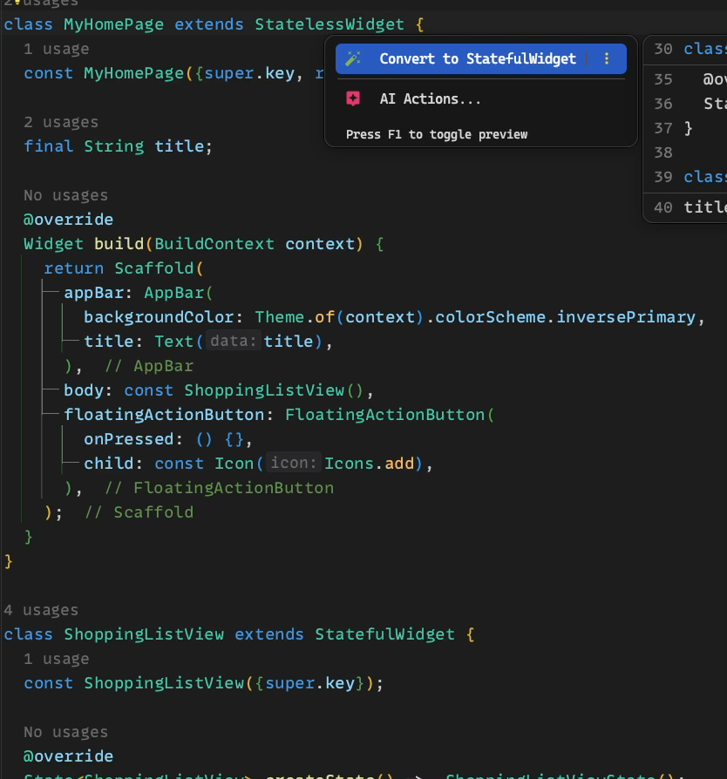
lib/main.dart
@override Widget build(BuildContext context) { return ListView.builder( itemCount: _shoppingList.items.length, itemBuilder: (context, index) { final item = _shoppingList.items[index]; return _ShoppingListItemTile( key: ValueKey(item.id), item: item, ); }, ); }
Notes:
Als erstes: MyHomePage in Stateful Widget konvertieren (via IDE)

Slide 251
lib/main.dart
class _MyHomePageState extends State<MyHomePage> { ShoppingList _shoppingList = ShoppingList() ..addItem( name: 'Banana', quantity: 3, ) ..addItem( name: 'Apple', quantity: 5, ); … }
Notes:
_shoppingList in _myHomePageState ziehen

Slide 252
lib/main.dart
class ShoppingListView extends StatefulWidget { const ShoppingListView({super.key}); @override State<ShoppingListView> createState() => _ShoppingListViewState(); } class _ShoppingListViewState extends State<ShoppingListView> { @override Widget build(BuildContext context) { return ListView.builder( itemCount: _shoppingList.items.length, itemBuilder: (context, index) { final item = _shoppingList.items[index]; return _ShoppingListItemTile( key: ValueKey(item.id), item: item, ); }, ); } }
Notes:
ShoppingListView in Stateless Widget umwandeln

Slide 253
lib/main.dart
class ShoppingListView extends StatelessWidget { const ShoppingListView({super.key}); @override Widget build(BuildContext context) { return ListView.builder( itemCount: _shoppingList.items.length, itemBuilder: (context, index) { final item = _shoppingList.items[index]; return _ShoppingListItemTile( key: ValueKey(item.id), item: item, ); }, ); } }
Notes:
Das geht leider nur manuell

Slide 254
lib/main.dart
class ShoppingListView extends StatelessWidget { const ShoppingListView({ required this.shoppingList, super.key, }); final ShoppingList shoppingList; @override Widget build(BuildContext context) { return ListView.builder( itemCount: shoppingList.items.length, itemBuilder: (context, index) { final item = shoppingList.items[index]; return _ShoppingListItemTile( key: ValueKey(item.id), item: item, ); }, ); } }
Notes:
_shoppingList in _MyHomePageState ziehen

Slide 255
lib/main.dart
@override Widget build(BuildContext context) { return Scaffold( appBar: AppBar( backgroundColor: Theme.of(context).colorScheme.inversePrimary, title: Text(widget.title), ), body: const ShoppingListView(), floatingActionButton: FloatingActionButton( onPressed: () {}, child: const Icon(Icons.add), ), ); }
Notes:
_shoppingList von MyHomePage in ShoppingListView ziehen

Slide 256
lib/main.dart
@override Widget build(BuildContext context) { return Scaffold( appBar: AppBar( backgroundColor: Theme.of(context).colorScheme.inversePrimary, title: Text(widget.title), ), body: ShoppingListView( shoppingList: _shoppingList, ), floatingActionButton: FloatingActionButton( onPressed: () {}, child: const Icon(Icons.add), ), ); }
Notes:
Jetzt können wir die ShoppingList modifizieren

Slide 257
lib/main.dart
@override Widget build(BuildContext context) { return Scaffold( appBar: AppBar( backgroundColor: Theme.of(context).colorScheme.inversePrimary, title: Text(widget.title), ), body: ShoppingListView( shoppingList: _shoppingList, ), floatingActionButton: FloatingActionButton( onPressed: () { _shoppingList.addItem(name: 'New item', quantity: 1); }, child: const Icon(Icons.add), ), ); }
Notes:
Jetzt haben wir Zugriff auf die ShoppingList im FloatingActionButton

Slide 258
lib/main.dart
@override Widget build(BuildContext context) { return Scaffold( appBar: AppBar( backgroundColor: Theme.of(context).colorScheme.inversePrimary, title: Text(widget.title), ), body: ShoppingListView( shoppingList: _shoppingList,), floatingActionButton: FloatingActionButton( onPressed: () { setState(() { _shoppingList.addItem(name: 'New item', quantity: 1); }); }, child: const Icon(Icons.add), ), ); }
Notes:
setState nicht vergessen!

Slide 259

lib/main.dart
@override Widget build(BuildContext context) { return Scaffold( appBar: AppBar( backgroundColor: Theme.of(context).colorScheme.inversePrimary, title: Text(widget.title), ), body: ShoppingListView( shoppingList: _shoppingList, ), floatingActionButton: FloatingActionButton( onPressed: () { _shoppingList.addItem(name: 'New item', quantity: 1); }, child: const Icon(Icons.add), ), ); }

Slide 260
Shopping list app
Creating a new page to add items

Slide 261
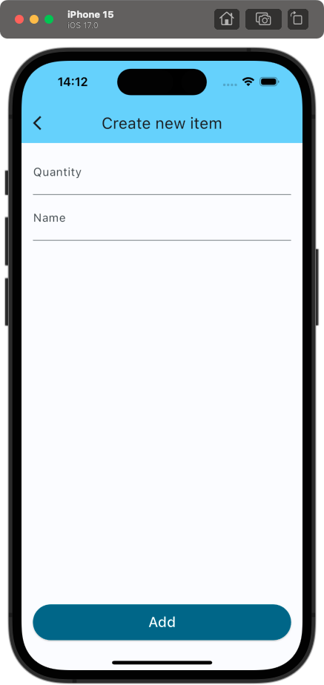
Shopping list app
Creating a new page to add items

Slide 262
Shopping list app
Breaking down the design

Slide 270
Shopping list app
Implementing the design

Slide 271
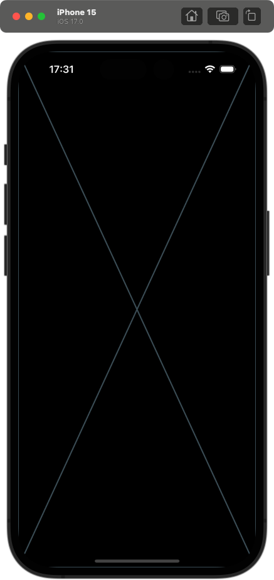
lib/main.dart
class CreateNewShoppingListItemPage extends StatelessWidget { const CreateNewShoppingListItemPage({super.key}); @override Widget build(BuildContext context) { return const Placeholder(); } }
Notes:
setState nicht vergessen!

Slide 272
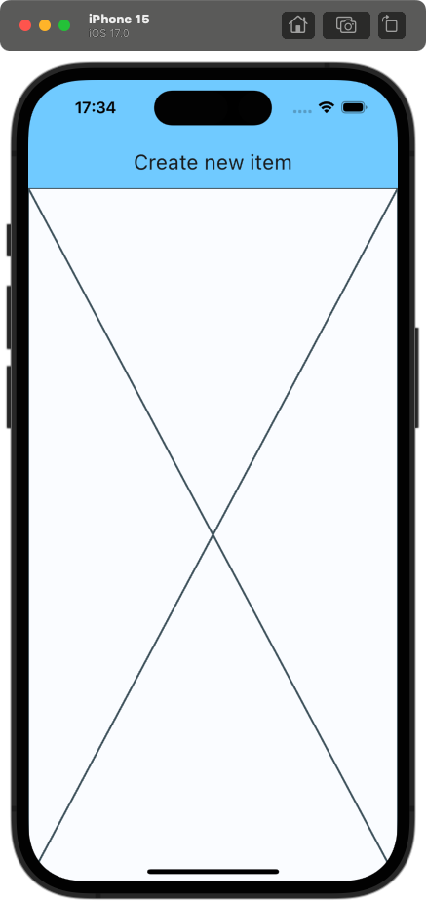
lib/main.dart
class CreateNewShoppingListItemPage extends StatelessWidget { const CreateNewShoppingListItemPage({ super.key, required this.shoppingList, }); final ShoppingList shoppingList; @override Widget build(BuildContext context) { return Scaffold( appBar: AppBar( backgroundColor: Theme.of(context).colorScheme.inversePrimary, title: const Text('Create new item'), ), body: _CreateNewItemForm( shoppingList: shoppingList, ), ); } }

Slide 273
lib/main.dart
class _CreateNewItemForm extends StatefulWidget { const _CreateNewItemForm({ super.key, required this.shoppingList, }); final ShoppingList shoppingList; @override State<_CreateNewItemForm> createState() => _CreateNewItemFormState(); }
class _CreateNewItemFormState extends State<_CreateNewItemForm> { @override Widget build(BuildContext context) { return const Placeholder(); } }

Slide 274
lib/main.dart
class _CreateNewItemFormState extends State<_CreateNewItemForm> { @override Widget build(BuildContext context) { return Form( child: , ); } }

Slide 275
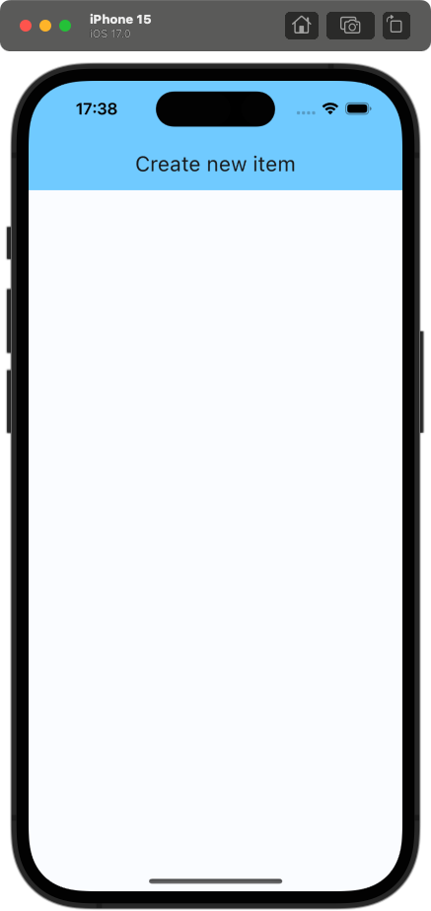
lib/main.dart
class _CreateNewItemFormState extends State<_CreateNewItemForm> { @override Widget build(BuildContext context) { return Form( child: Column( children: [], ), ); } }

Slide 276
Column
“A widget that displays its children in a vertical array.“

Slide 277
Row
“A widget that displays its children in a horizontal array.“

Slide 278
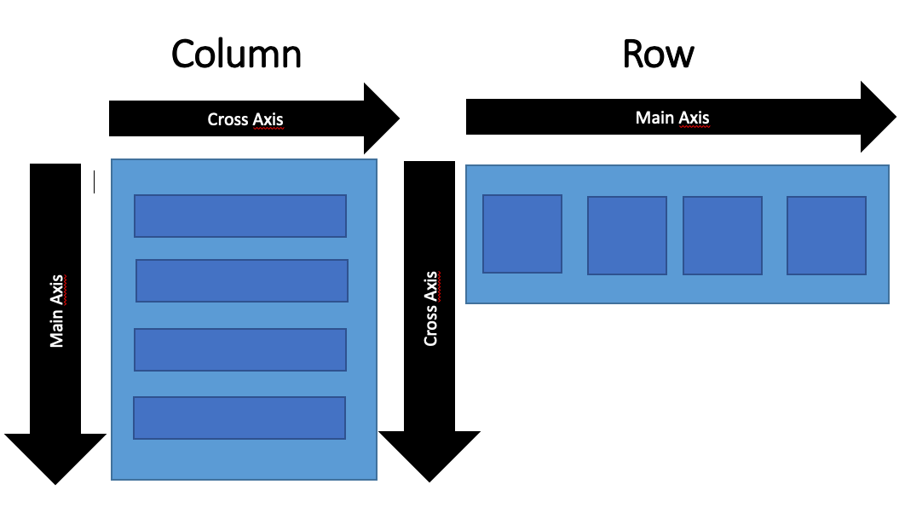
Column/Row
children: “The widgets below this widget in the tree.“
mainAxisAlignment: “How the children should be placed along the main axis.“
mainAxisSize: “How much space should be occupied in the main axis.“
crossAxisAlignment: “How the children should be placed along the cross axis.“
see all properties here

Slide 279
Column/Row vs. Flexbox
mainAxisAlignment
justify-content
start
end
center
spaceBetween
spaceAround
spaceEvenly
start
end
center
space-between
space-around
space-evenly

Slide 280
Column/Row vs. Flexbox
crossAxisAlignment
align-items
start
end
center
stretch
baseline
start
end
center
stretch
baseline

Slide 281
Column/Row vs. Flexbox
Expanded
flex
“A widget that expands a child of Row, Column, or Flex so that the child fills the available space.“
”flex CSS shorthand property sets how a flex item will grow or shrink to fit the space available in its flex container.“

Slide 282
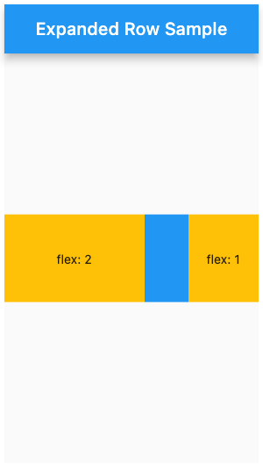
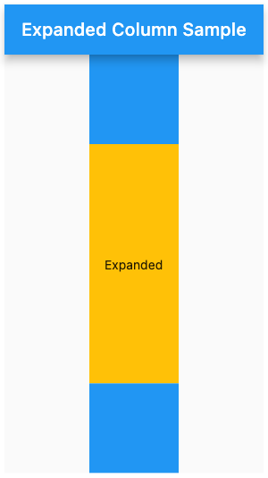
Expanded

Slide 283
lib/main.dart
class _CreateNewItemFormState extends State<_CreateNewItemForm> { @override Widget build(BuildContext context) { return Form( child: Column( children: [], ), ); } }

Slide 284
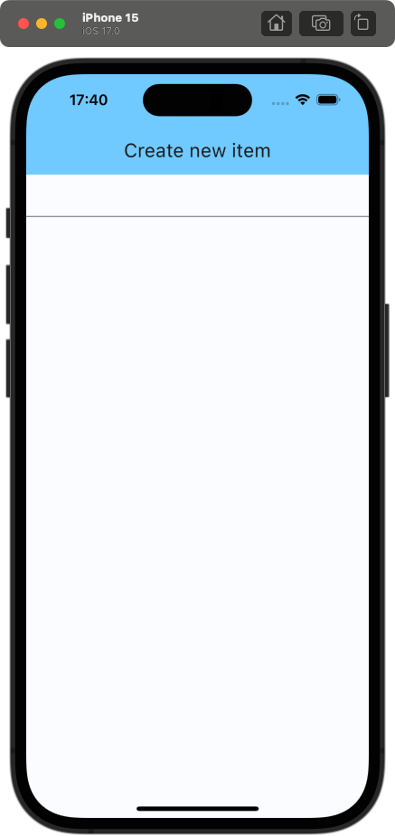
lib/main.dart
class _CreateNewItemFormState extends State<_CreateNewItemForm> { @override Widget build(BuildContext context) { return Form( child: Column( children: [ TextFormField(), ], ), ); } }
Notes:
setState nicht vergessen!

Slide 285
TextFormField
“A FormField that contains a TextField. This is a convenience widget that wraps a TextField widget in a FormField.“
Notes:
TextField mit zusätzlichen Properties, die für ein Benutzen in einer Form nützlich sind

Slide 286
TextFormField
decoration: “The decoration to show around the text field.“
controller: “Controls the text being edited.“
validator: “An optional method that validates the input. Returns an error string to display if the input is invalid, or null otherwise.“
see all properties here
Notes:
Padding ist nicht wie in CSS durch einen string oder eine Zahl definiert, sondern durch die EdgeInsets Klasse

Slide 287
lib/main.dart
class _CreateNewItemFormState extends State<_CreateNewItemForm> { @override Widget build(BuildContext context) { return Form( child: Column( children: [ TextFormField(), ], ), ); } }

Slide 288
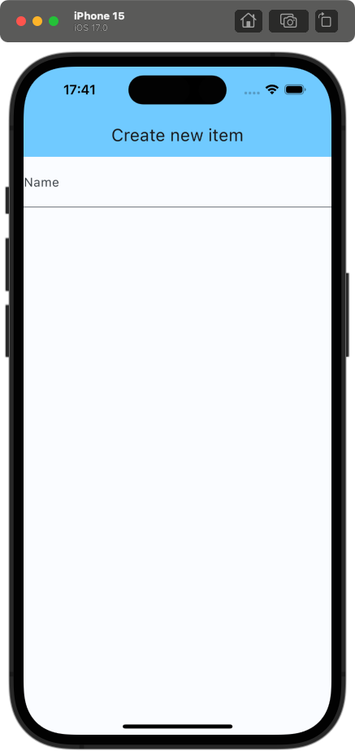
lib/main.dart
class _CreateNewItemFormState extends State<_CreateNewItemForm> { @override Widget build(BuildContext context) { return Form( child: Column( children: [ TextFormField( decoration: InputDecoration( labelText: 'Name', ), ), ], ), ); } }
👆 give TextField label
Notes:
Ist gerade ein wenig eingeengt

Slide 289
Padding
“A widget that insets its child by the given padding.“

Slide 290
Padding
child: “The widget below this widget in the tree.“
padding: “The amount of space by which to inset the child.“
see all properties here
Notes:
Padding ist nicht wie in CSS durch einen string oder eine Zahl definiert, sondern durch die EdgeInsets Klasse

Slide 291
Shopping list app
Understanding EdgeInsets

Slide 292
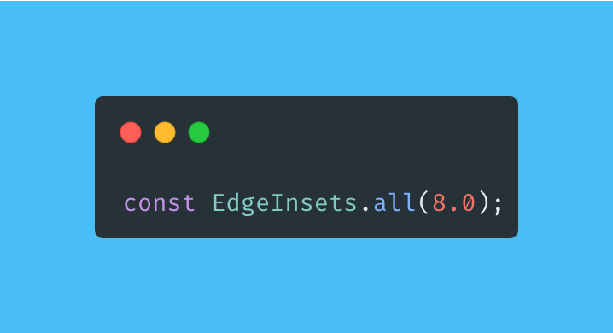
EdgeInsets.all

Slide 293
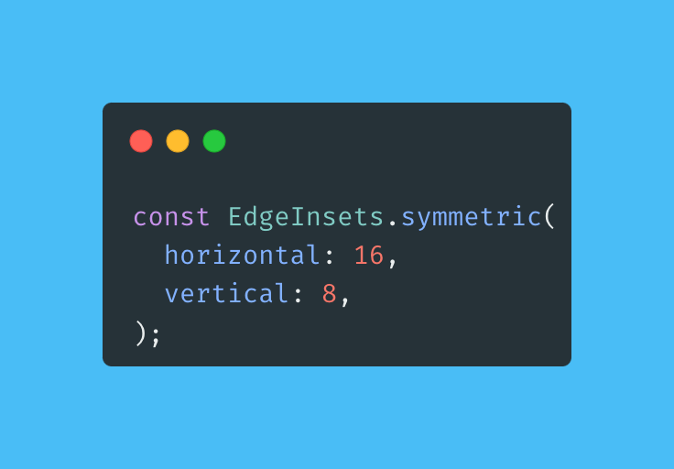
EdgeInsets.symmetric

Slide 294
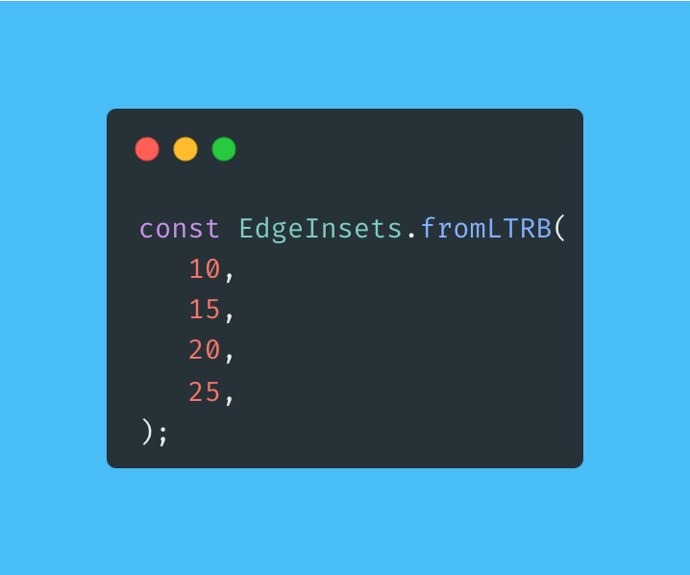
EdgeInsets.fromLTRB

Slide 295

EdgeInsets.only

Slide 296
lib/main.dart
class _CreateNewItemFormState extends State<_CreateNewItemForm> { @override Widget build(BuildContext context) { return Form( child: Column( children: [ TextFormField( decoration: InputDecoration( labelText: 'Name', ), ), ], ), ); } }

Slide 297

lib/main.dart
@override Widget build(BuildContext context) { return Padding( padding: const EdgeInsets.symmetric( horizontal: 16, vertical: 8, ), child: Form( child: Column( children: [ TextFormField( decoration: InputDecoration( labelText: 'Name', ), ), ], ), ), ); }
Notes:
Jetzt fehlt noch das zweite TextField und der Button

Slide 298

lib/main.dart
@override Widget build(BuildContext context) { return Padding( padding: const EdgeInsets.symmetric( horizontal: 16, vertical: 8, ), child: Form( child: Column( children: [ TextFormField( decoration: InputDecoration( labelText: 'Name', ), ), ], ), ), ); }
Notes:
Wrappen geht einfach mit Shortcut (Option + Enter)

Slide 299

lib/main.dart
[ TextFormField( decoration: InputDecoration( labelText: 'Quantity', ), ), TextFormField( decoration: InputDecoration( labelText: 'Name', ), ), ElevatedButton( onPressed: () {}, child: const Text('Add'), ), ]

Slide 300

lib/main.dart
ElevatedButton( style: ElevatedButton.styleFrom( backgroundColor: Theme.of(context).colorScheme.primary, foregroundColor: Theme.of(context).colorScheme.onPrimary, minimumSize: const Size.fromHeight(50.0), ), onPressed: () {}, child: const Text( 'Add', style: TextStyle(fontSize: 20), ), ),
Notes:
Wir wollen den Button nach ganz unten bewegen => Die TextFelder müssen den ganzen Space ausfüllen

Slide 301

lib/main.dart
[ Expanded( child: Column( children: [ TextFormField( ... ), TextFormField( ... ), ], ), ), ElevatedButton( ... ), ]
Notes:
Alternative Lösung: mainAxisAlignment der äußeren Column auf MainAxisAlignment.spaceBetween setzen
Der Button liegt jetzt irgendwie unter einem Control vom iPhone => wie verhindern wir das? Man könnte natürlich einfach ein wenig Bottom-Padding geben, allerdings ist dieser Wert auf jedem Device anders

Slide 302
SafeArea
“A widget that insets its child by sufficient padding to avoid intrusions by the operating system.“
Notes:
Dafür gibt es SafeArea

Slide 303

lib/main.dart
return SafeArea( child: ... );
Notes:
Wir wrappen alles in einer SafeArea => Tada

Slide 304
Shopping list app
Capturing input

Slide 305
Capturing input
Two viable approaches

Slide 306
Capturing input
Two viable approaches
Using a state variable and setting it in the onChanged callback of the TextFormField
Using a TextEditingController

Slide 307
Capturing input
State variables
TextEditingController
Rerenders the whole widget tree when the input changes
Useful when the input is displayed somewhere else than the TextField itself
Only rerenders the TextField
Requires disposing and initializing

Slide 308
lib/main.dart
class _CreateNewItemFormState extends State<_CreateNewItemForm> { late final TextEditingController _quantityController; late final TextEditingController _nameController; ... }
Notes:
setState nicht vergessen!

Slide 309
lib/main.dart
class _CreateNewItemFormState extends State<_CreateNewItemForm> { late final TextEditingController _quantityController; late final TextEditingController _nameController; ... }
👆 tells the compiler that _nameController is initialized before being used
Notes:
setState nicht vergessen!

Slide 310
lib/main.dart
class _CreateNewItemFormState extends State<_CreateNewItemForm> { late final TextEditingController _quantityController; late final TextEditingController _nameController; @override void initState() { super.initState(); _quantityController = TextEditingController(); _nameController = TextEditingController(); }
... }
Notes:
setState nicht vergessen!

Slide 311
Shopping list app
What is initState? – Lifecycle methods of a StatefulWidget

Slide 312
Lifecycle methods of a StatefulWidget (processed in order)
createState()
mounted = true
initState()
didChangeDependencies()
build()
didUpdateWidget()
setState()
deactivate()
dispose()
mounted = false

Slide 313
Lifecycle methods of a StatefulWidget (processed in order)
createState()
mounted = true
initState()
didChangeDependencies()
build()
didUpdateWidget()
setState()
deactivate()
dispose()
mounted = false
Notes:
Wirklich relevant sind nur diese

Slide 314
mounted=true
Turns true when buildContext is assigned to the state

Slide 315
Lifecycle methods of a StatefulWidget
createState()
mounted = true
initState()
didChangeDependencies()
build()
didUpdateWidget()
setState()
deactivate()
dispose()
mounted = false

Slide 316
initState()
Is the first method called after the creation of the widget
Only called once!
Must call super.initState() before doing anything else
Useful for:
Initializing data that relies on the BuildContext
Initializing properties that rely on properties from the widget itself
Subscribing to any object that could change the data on the widget

Slide 317
Lifecycle methods of a StatefulWidget
createState()
mounted = true
initState()
didChangeDependencies()
build()
didUpdateWidget()
setState()
deactivate()
dispose()
mounted = false

Slide 318
build()
Called on every render => Called very often!
Must return a widget

Slide 319
Lifecycle methods of a StatefulWidget
createState()
mounted = true
initState()
didChangeDependencies()
build()
didUpdateWidget()
setState()
deactivate()
dispose()
mounted = false

Slide 320
dispose()
Called when the state is permantently removed from the tree
Needs to call super.dispose() AFTER everything else
Useful for:
Unsubscribing
Cancelling animations
Calling dispose methods of state members (e.g. TextEditingController)

Slide 321
Lifecycle methods of a StatefulWidget
createState()
mounted = true
initState()
didChangeDependencies()
build()
didUpdateWidget()
setState()
deactivate()
dispose()
mounted = false

Slide 322
mounted=false
Turns false when the state object can never remount
It is an ERROR to call setState when mounted is false

Slide 323
Shopping list app
Using our knowledge to properly handle the lifecycle of a TextEditingController

Slide 324
lib/main.dart
class _CreateNewItemFormState extends State<_CreateNewItemForm> { late final TextEditingController _quantityController; late final TextEditingController _nameController; @override void initState() { super.initState(); _quantityController = TextEditingController(); _nameController = TextEditingController(); }
... }

Slide 325
lib/main.dart
class _CreateNewItemFormState extends State<_CreateNewItemForm> { late TextEditingController _quantityController; late TextEditingController _nameController; @override void initState() { super.initState(); _quantityController = TextEditingController(); _nameController = TextEditingController(); } @override void dispose() { _quantityController.dispose(); _nameController.dispose(); super.dispose(); } ... }

Slide 326
lib/main.dart
[ TextFormField( decoration: InputDecoration( labelText: 'Quantity', ), ), TextFormField( decoration: InputDecoration( labelText: 'Name', ), ), ]
Notes:
setState nicht vergessen!

Slide 327
lib/main.dart
[ TextFormField( controller: _quantityController, decoration: InputDecoration( labelText: 'Quantity', ), ), TextFormField( controller: _nameController, decoration: InputDecoration( labelText: 'Name', ), ), ]
Notes:
setState nicht vergessen!

Slide 328
Shopping list app
Adding validation

Slide 329
lib/main.dart
[ TextFormField( controller: _quantityController, decoration: InputDecoration( labelText: 'Quantity', ), ), TextFormField( controller: _nameController, decoration: InputDecoration( labelText: 'Name', ), ), ]
Notes:
setState nicht vergessen!

Slide 330
lib/main.dart
[ TextFormField( controller: _quantityController, keyboardType: TextInputType.numberWithOptions( decimal: false, signed: false, ), decoration: InputDecoration( labelText: 'Quantity', ), ), TextFormField( validator: (value) { if (value == null || value.isEmpty) { return 'Please enter a name'; } return null; }, controller: _nameController, decoration: InputDecoration( labelText: 'Name', ), ), ]
Notes:
setState nicht vergessen!

Slide 331
lib/main.dart
final _formKey = GlobalKey<FormState>(); @override Widget build(BuildContext context) { return SafeArea( child: Padding( padding: ..., child: Form( key: _formKey, child: ... ), ), ); }
👆uniquely identifies the form and allows validation
Notes:
setState nicht vergessen!

Slide 332
lib/main.dart
ElevatedButton( style: ElevatedButton.styleFrom( backgroundColor: Theme.of(context).colorScheme.primary, foregroundColor: Theme.of(context).colorScheme.onPrimary, minimumSize: const Size.fromHeight(50.0), ), onPressed: () {}, child: const Text( 'Add', style: TextStyle(fontSize: 20), ), ),
Notes:
setState nicht vergessen!

Slide 333
lib/main.dart
ElevatedButton( style: ..., onPressed: () { if (!_formKey.currentState!.validate()) { return; } }, child: ..., ),
Notes:
setState nicht vergessen!

Slide 334
Shopping list app
Extracting input

Slide 335
lib/main.dart
ElevatedButton( style: ..., onPressed: () { if (!_formKey.currentState!.validate()) { return; } }, child: ..., ),
Notes:
setState nicht vergessen!

Slide 336
lib/main.dart
ElevatedButton( style: ..., onPressed: () { if (!_formKey.currentState!.validate()) { return; }
final quantity = int.tryParse(_quantityController.text) ?? 1;
final name = _nameController.text; }, child: ..., ),
Notes:
setState nicht vergessen!

Slide 337
lib/main.dart
ElevatedButton( style: ..., onPressed: () { if (!_formKey.currentState!.validate()) { return; }
final quantity = int.tryParse(_quantityController.text) ?? 1;
final name = _nameController.text; }, child: ..., ),
Elvis operator 👇

Slide 338
lib/main.dart
ElevatedButton( style: ..., onPressed: () { if (!_formKey.currentState!.validate()) { return; }
final quantity = int.tryParse(_quantityController.text) ?? 1; final name = _nameController.text;
widget.shoppingList.addItem( name: name, quantity: quantity, );
}, child: ..., ),
Notes:
Nun wollen wir zurück zur Ansicht mit der ShoppingList => Wie werden wir den aktuellen Bildschirm los?

Slide 339
Shopping list app
Navigating to the new page

Slide 340
Navigators
Navigator 1.0
Navigator 2.0
Imperative API
Limited control over navigation stack
Easy to use
Sufficient for many usecases
Declarative API
Full control
Complex
Mostly used via third party packages like auto_route or go_router

Slide 341
Two types of navigators
Navigator 1.0
Navigator 2.0
👈 We will use the simpler approach
Imperative API
Limited control over navigation stack
Easy to use
Sufficient for many usecases
Declarative API
Full control
Complex
Mostly used via third party packages like auto_route or go_router

Slide 342

Pushing new routes

Slide 343

Popping routes

Slide 344

Nice to know
Navigator is an InheritedWidget and can therefore be accessed from anywhere in a MaterialApp

Slide 345
lib/main.dart
ElevatedButton( style: ..., onPressed: () { if (!_formKey.currentState!.validate()) { return; }
final quantity = int.tryParse(_quantityController.text) ?? 1; final name = _nameController.text;
widget.shoppingList.addItem( name: name, quantity: quantity, );
}, child: ..., ),
Notes:
Nun wollen wir zurück zur Ansicht mit der ShoppingList => Wie werden wir den aktuellen Bildschirm los?

Slide 346
lib/main.dart
ElevatedButton( style: ..., onPressed: () { if (!_formKey.currentState!.validate()) { return; }
final quantity = int.tryParse(_quantityController.text) ?? 1; final name = _nameController.text;
widget.shoppingList.addItem( name: name, quantity: quantity, );
Navigator.of(context).pop();
}, child: ..., ),

Slide 347
lib/main.dart
FloatingActionButton( onPressed: () { setState(() { _shoppingList.addItem(name: 'New item', quantity: 1); }); }, child: const Icon(Icons.add), )

Slide 348
lib/main.dart
FloatingActionButton( onPressed: () async { await Navigator.of(context).push( MaterialPageRoute( builder: (context) { return CreateNewShoppingListItemPage( shoppingList: _shoppingList, ); }, ), ); }, child: const Icon(Icons.add), )
Notes:
ganz kurz async await erwähnen

Slide 349
lib/main.dart
FloatingActionButton( onPressed: () async { await Navigator.of(context).push<(int, String)>( MaterialPageRoute( builder: (context) { return CreateNewShoppingListItemPage( shoppingList: _shoppingList, ); }, ), ); if(mounted) { setState(() { // rerender }); } }, child: const Icon(Icons.add), )
👈 check if the widget is still mounted after an asynchronous operation

Slide 350

lib/main.dart
FloatingActionButton( onPressed: () async { await Navigator.of(context).push<(int, String)>( MaterialPageRoute( builder: (context) { return CreateNewShoppingListItemPage( shoppingList: _shoppingList, ); }, ), ); if(mounted) { setState(() { // rerender }); } }, child: const Icon(Icons.add), )
Notes:
App fertig, aber: Irgendwie unschön die ShoppingList den ganzen Widget-Tree hinabreichen zu müssen => geht das besser?

Slide 351

lib/main.dart
FloatingActionButton( onPressed: () async { await Navigator.of(context).push<(int, String)>( MaterialPageRoute( builder: (context) { return CreateNewShoppingListItemPage( shoppingList: _shoppingList, ); }, ), ); if(mounted) { setState(() { // rerender }); } }, child: const Icon(Icons.add), )
Notes:
App fertig, aber: Irgendwie unschön die ShoppingList den ganzen Widget-Tree hinabreichen zu müssen => geht das besser?

Slide 352
Advanced state management
The problem

Slide 353
MyApp
MyHomePage
ShoppingListView
CreateNewShoppingListItemPage
_ShoppingListItemTile
_ShoppingListItemTile
_CreateNewItemForm
…

Slide 354
MyApp
MyHomePage
shoppingList
ShoppingListView
CreateNewShoppingListItemPage
_ShoppingListItemTile
_ShoppingListItemTile
_CreateNewItemForm
…

Slide 355
MyApp
MyHomePage
shoppingList
ShoppingListView
shoppingList
CreateNewShoppingListItemPage
_ShoppingListItemTile
_ShoppingListItemTile
_CreateNewItemForm
…

Slide 356
MyApp
MyHomePage
shoppingList
ShoppingListView
shoppingList
CreateNewShoppingListItemPage
shoppingList
_ShoppingListItemTile
_ShoppingListItemTile
_CreateNewItemForm
…

Slide 357
MyApp
MyHomePage
shoppingList
ShoppingListView
shoppingList
CreateNewShoppingListItemPage
shoppingList
_ShoppingListItemTile
_ShoppingListItemTile
_CreateNewItemForm
shoppingList
…

Slide 358
MyApp
MyHomePage
shoppingList
ShoppingListView
shoppingList
CreateNewShoppingListItemPage
shoppingList
_ShoppingListItemTile
_ShoppingListItemTile
_CreateNewItemForm
shoppingList
…

Slide 359
MyApp
MyHomePage
shoppingList
ShoppingListView
shoppingList
CreateNewShoppingListItemPage
shoppingList
_ShoppingListItemTile
_ShoppingListItemTile
_CreateNewItemForm
shoppingList
…

Slide 360
Advanced state management
The idea

Slide 361
MyApp
MyHomePage
shoppingList
ShoppingListView
shoppingList
CreateNewShoppingListItemPage
shoppingList
_ShoppingListItemTile
_ShoppingListItemTile
_CreateNewItemForm
shoppingList
…

Slide 362
MyApp
SomeWidget
MyHomePage
shoppingList
ShoppingListView
shoppingList
CreateNewShoppingListItemPage
shoppingList
_ShoppingListItemTile
_ShoppingListItemTile
_CreateNewItemForm
shoppingList
…

Slide 363
MyApp
SomeWidget
shoppingList
MyHomePage
ShoppingListView
CreateNewShoppingListItemPage
_ShoppingListItemTile
_ShoppingListItemTile
_CreateNewItemForm
…

Slide 364
MyApp
SomeWidget
shoppingList
MyHomePage
ShoppingListView
CreateNewShoppingListItemPage
_ShoppingListItemTile
_ShoppingListItemTile
_CreateNewItemForm
…

Slide 365
Advanced state management
Options

Slide 366


Slide 367





Provider
bloc
riverpod
redux
GetX

Slide 368

Provider
bloc
riverpod
redux
GetX

Slide 369

Summary
Widgets are used to configure other widgets
There is a widget for everything
Rerender using setState
Knowing the lifecycle methods is important

Slide 370
Outlook

Slide 371


Slide 373


Slide 374
Practice makes perfect
Build your own app

Slide 375
Requirements
Flutter installation

Slide 376

Requirements
Flutter installation

Slide 377
Requirements
Flutter installation
A physical device or an emulator

Slide 378

Requirements
Flutter installation
A physical device or an emulator
A little patience

Slide 379
Requirements
Flutter installation
A physical device or an emulator
A little patience
Creativity

Slide 380

Don’t be afraid to ask

